Slide 1
Therapists template
Click to start

Slide 2
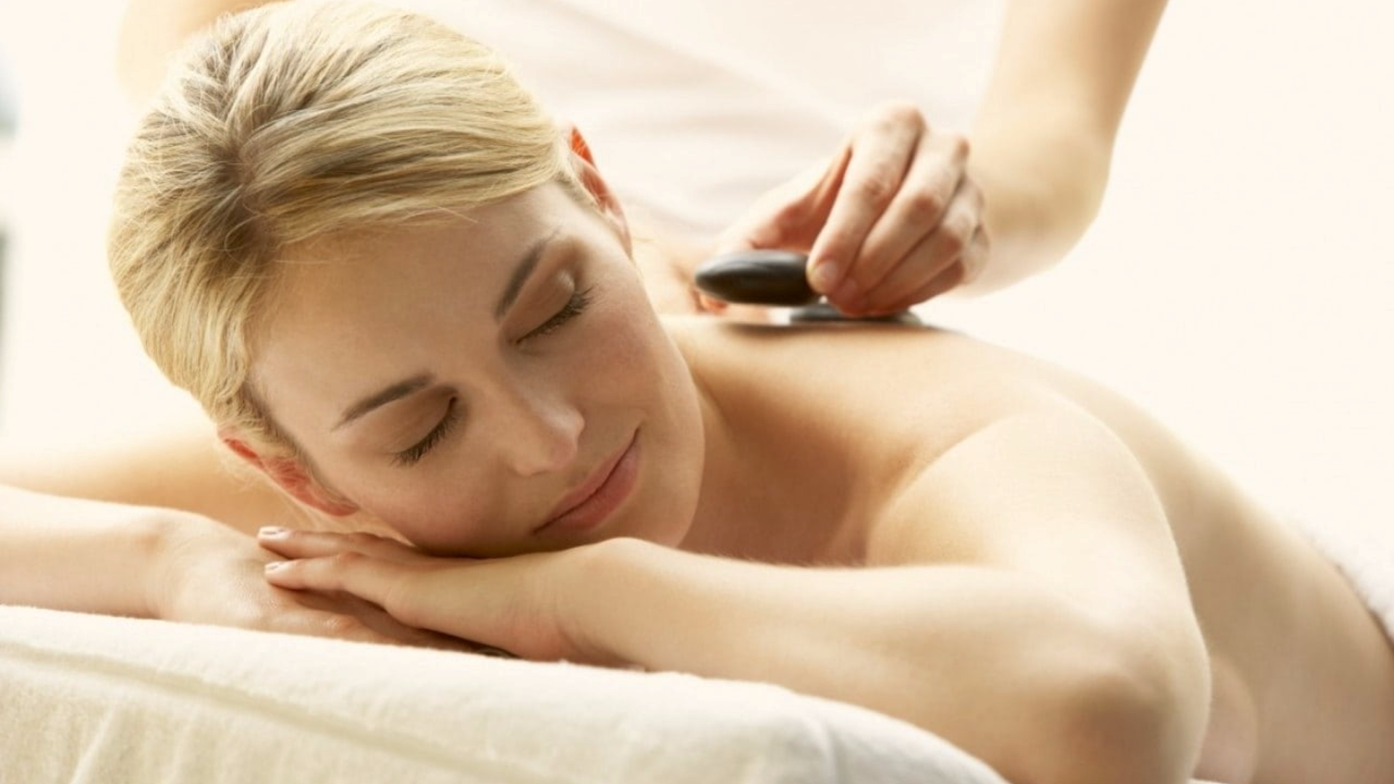

Home
Therapists
Book now
About us
Contacts
Profile
Sign out
Germany Mobile Spa
Relax. Rejuvenate. Renew.
Discover the healing power of touch. Our expert massage therapies not only melt away stress but also improve circulation, relieve muscle tension, and promote overall well-being. Invest in your health —because you deserve it.
Find your closest therapist

Slide 3
Home
Therapists
Book now
About us
Contacts
Profile
Sign out
Germany Mobile Spa
Relax. Rejuvenate. Renew.
Discover the healing power of touch. Our expert massage therapies not only melt away stress but also improve circulation, relieve muscle tension, and promote overall well-being. Invest in your health —because you deserve it.
Find your closest therapist

Slide 4
Home
Therapists
Book now
About us
Contacts
Profile
Sign out
Germany Mobile Spa

Slide 5




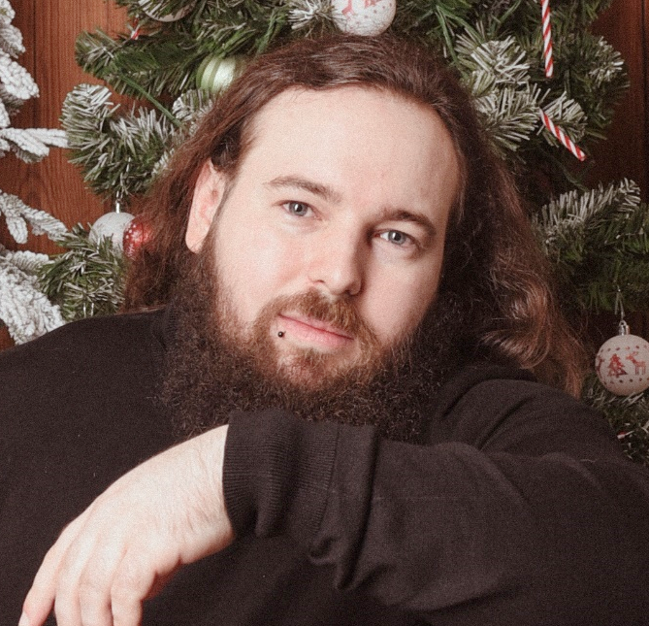


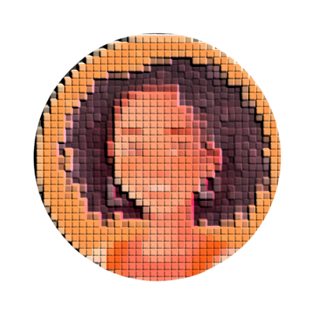
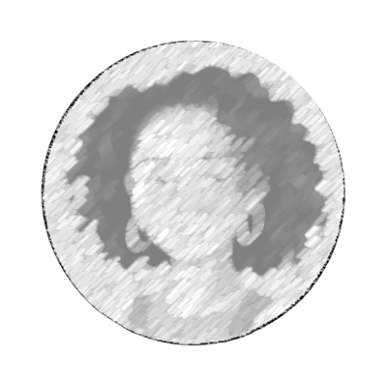



Home
Therapists
Book now
About us
Contacts
Profile
Sign out
Germany Mobile Spa
Sort by distance with address
Country
Find by city
Services
Sort by city
Select gender
Maria Hopkin Thai Therapist
Kurfürstendamm 213, 10719 Berlin 5.56 km away
Roger Iskrenov Personal Yoga Trainer
Unter den Linden 12, 10117 Berlin 0.19 km away
Sofia Bennett Deep Tissue Specialist
Schönhauser Allee 142, 10437 Berlin 3.62 km away
Natalie Koenig Aromatherapy Massage Therapist
Reeperbahn 100, 20359 Hamburg 257.02 km away
Liam Harrison Sports Massage Therapist
Schulterblatt 36, 20357 Hamburg 257.54 km away
Jasper Malik Thai Yoga Massage Trainer
Neckarstraße 115, 70190 Stuttgart 509.21 km away
Amelia Chen Reflexology Expert
Calwer Straße 23, 70173 Stuttgart 511.35 km away
Maya Gupta Prenatal Massage Expert
Alsterufer 31, 20354 Hamburg 255.55 km away
Marcus Petrov Myofascial Release Therapist
Königstraße 44, 70173 Stuttgart 511.06 km away
Elena Navarro Hot Stone Massage Practitioner
Karl-Marx-Straße 85, 12043 Berlin 5.12 km away

Slide 6
Home
Therapists
Book now
About us
Contacts
Profile
Sign out
Germany Mobile Spa
|
Country
Find by city
Services
Sort by city
Select gender
Maria Hopkin Thai Therapist
Kurfürstendamm 213, 10719 Berlin 5.56 km away
Roger Iskrenov Personal Yoga Trainer
Unter den Linden 12, 10117 Berlin 0.19 km away
Sofia Bennett Deep Tissue Specialist
Schönhauser Allee 142, 10437 Berlin 3.62 km away
Natalie Koenig Aromatherapy Massage Therapist
Reeperbahn 100, 20359 Hamburg 257.02 km away
Liam Harrison Sports Massage Therapist
Schulterblatt 36, 20357 Hamburg 257.54 km away
Jasper Malik Thai Yoga Massage Trainer
Neckarstraße 115, 70190 Stuttgart 509.21 km away
Amelia Chen Reflexology Expert
Calwer Straße 23, 70173 Stuttgart 511.35 km away
Maya Gupta Prenatal Massage Expert
Alsterufer 31, 20354 Hamburg 255.55 km away
Marcus Petrov Myofascial Release Therapist
Königstraße 44, 70173 Stuttgart 511.06 km away
Elena Navarro Hot Stone Massage Practitioner
Karl-Marx-Straße 85, 12043 Berlin 5.12 km away

Slide 7
Home
Therapists
Book now
About us
Contacts
Profile
Sign out
Germany Mobile Spa
F
Country
Find by city
Services
Sort by city
Select gender
Maria Hopkin Thai Therapist
Kurfürstendamm 213, 10719 Berlin 5.56 km away
Roger Iskrenov Personal Yoga Trainer
Unter den Linden 12, 10117 Berlin 0.19 km away
Sofia Bennett Deep Tissue Specialist
Schönhauser Allee 142, 10437 Berlin 3.62 km away
Natalie Koenig Aromatherapy Massage Therapist
Reeperbahn 100, 20359 Hamburg 257.02 km away
Liam Harrison Sports Massage Therapist
Schulterblatt 36, 20357 Hamburg 257.54 km away
Jasper Malik Thai Yoga Massage Trainer
Neckarstraße 115, 70190 Stuttgart 509.21 km away
Amelia Chen Reflexology Expert
Calwer Straße 23, 70173 Stuttgart 511.35 km away
Maya Gupta Prenatal Massage Expert
Alsterufer 31, 20354 Hamburg 255.55 km away
Marcus Petrov Myofascial Release Therapist
Königstraße 44, 70173 Stuttgart 511.06 km away
Elena Navarro Hot Stone Massage Practitioner
Karl-Marx-Straße 85, 12043 Berlin 5.12 km away

Slide 8
Home
Therapists
Book now
About us
Contacts
Profile
Sign out
Germany Mobile Spa
Fr
Country
Find by city
Services
Sort by city
Select gender
Maria Hopkin Thai Therapist
Kurfürstendamm 213, 10719 Berlin 5.56 km away
Roger Iskrenov Personal Yoga Trainer
Unter den Linden 12, 10117 Berlin 0.19 km away
Sofia Bennett Deep Tissue Specialist
Schönhauser Allee 142, 10437 Berlin 3.62 km away
Natalie Koenig Aromatherapy Massage Therapist
Reeperbahn 100, 20359 Hamburg 257.02 km away
Liam Harrison Sports Massage Therapist
Schulterblatt 36, 20357 Hamburg 257.54 km away
Jasper Malik Thai Yoga Massage Trainer
Neckarstraße 115, 70190 Stuttgart 509.21 km away
Amelia Chen Reflexology Expert
Calwer Straße 23, 70173 Stuttgart 511.35 km away
Maya Gupta Prenatal Massage Expert
Alsterufer 31, 20354 Hamburg 255.55 km away
Marcus Petrov Myofascial Release Therapist
Königstraße 44, 70173 Stuttgart 511.06 km away
Elena Navarro Hot Stone Massage Practitioner
Karl-Marx-Straße 85, 12043 Berlin 5.12 km away

Slide 9
Home
Therapists
Book now
About us
Contacts
Profile
Sign out
Germany Mobile Spa
Fri
Country
Find by city
Services
Sort by city
Select gender
Maria Hopkin Thai Therapist
Kurfürstendamm 213, 10719 Berlin 5.56 km away
Roger Iskrenov Personal Yoga Trainer
Unter den Linden 12, 10117 Berlin 0.19 km away
Sofia Bennett Deep Tissue Specialist
Schönhauser Allee 142, 10437 Berlin 3.62 km away
Natalie Koenig Aromatherapy Massage Therapist
Reeperbahn 100, 20359 Hamburg 257.02 km away
Liam Harrison Sports Massage Therapist
Schulterblatt 36, 20357 Hamburg 257.54 km away
Jasper Malik Thai Yoga Massage Trainer
Neckarstraße 115, 70190 Stuttgart 509.21 km away
Amelia Chen Reflexology Expert
Calwer Straße 23, 70173 Stuttgart 511.35 km away
Maya Gupta Prenatal Massage Expert
Alsterufer 31, 20354 Hamburg 255.55 km away
Marcus Petrov Myofascial Release Therapist
Königstraße 44, 70173 Stuttgart 511.06 km away
Elena Navarro Hot Stone Massage Practitioner
Karl-Marx-Straße 85, 12043 Berlin 5.12 km away

Slide 10
Home
Therapists
Book now
About us
Contacts
Profile
Sign out
Germany Mobile Spa
Frie
Country
Find by city
Services
Sort by city
Select gender
Maria Hopkin Thai Therapist
Kurfürstendamm 213, 10719 Berlin 5.56 km away
Roger Iskrenov Personal Yoga Trainer
Unter den Linden 12, 10117 Berlin 0.19 km away
Sofia Bennett Deep Tissue Specialist
Schönhauser Allee 142, 10437 Berlin 3.62 km away
Natalie Koenig Aromatherapy Massage Therapist
Reeperbahn 100, 20359 Hamburg 257.02 km away
Liam Harrison Sports Massage Therapist
Schulterblatt 36, 20357 Hamburg 257.54 km away
Jasper Malik Thai Yoga Massage Trainer
Neckarstraße 115, 70190 Stuttgart 509.21 km away
Amelia Chen Reflexology Expert
Calwer Straße 23, 70173 Stuttgart 511.35 km away
Maya Gupta Prenatal Massage Expert
Alsterufer 31, 20354 Hamburg 255.55 km away
Marcus Petrov Myofascial Release Therapist
Königstraße 44, 70173 Stuttgart 511.06 km away
Elena Navarro Hot Stone Massage Practitioner
Karl-Marx-Straße 85, 12043 Berlin 5.12 km away

Slide 11
Home
Therapists
Book now
About us
Contacts
Profile
Sign out
Germany Mobile Spa
Fried
Country
Find by city
Services
Sort by city
Select gender
Maria Hopkin Thai Therapist
Kurfürstendamm 213, 10719 Berlin 5.56 km away
Roger Iskrenov Personal Yoga Trainer
Unter den Linden 12, 10117 Berlin 0.19 km away
Sofia Bennett Deep Tissue Specialist
Schönhauser Allee 142, 10437 Berlin 3.62 km away
Natalie Koenig Aromatherapy Massage Therapist
Reeperbahn 100, 20359 Hamburg 257.02 km away
Liam Harrison Sports Massage Therapist
Schulterblatt 36, 20357 Hamburg 257.54 km away
Jasper Malik Thai Yoga Massage Trainer
Neckarstraße 115, 70190 Stuttgart 509.21 km away
Amelia Chen Reflexology Expert
Calwer Straße 23, 70173 Stuttgart 511.35 km away
Maya Gupta Prenatal Massage Expert
Alsterufer 31, 20354 Hamburg 255.55 km away
Marcus Petrov Myofascial Release Therapist
Königstraße 44, 70173 Stuttgart 511.06 km away
Elena Navarro Hot Stone Massage Practitioner
Karl-Marx-Straße 85, 12043 Berlin 5.12 km away

Slide 12
Home
Therapists
Book now
About us
Contacts
Profile
Sign out
Germany Mobile Spa
Friedr
Country
Find by city
Services
Sort by city
Select gender
Maria Hopkin Thai Therapist
Kurfürstendamm 213, 10719 Berlin 5.56 km away
Roger Iskrenov Personal Yoga Trainer
Unter den Linden 12, 10117 Berlin 0.19 km away
Sofia Bennett Deep Tissue Specialist
Schönhauser Allee 142, 10437 Berlin 3.62 km away
Natalie Koenig Aromatherapy Massage Therapist
Reeperbahn 100, 20359 Hamburg 257.02 km away
Liam Harrison Sports Massage Therapist
Schulterblatt 36, 20357 Hamburg 257.54 km away
Jasper Malik Thai Yoga Massage Trainer
Neckarstraße 115, 70190 Stuttgart 509.21 km away
Amelia Chen Reflexology Expert
Calwer Straße 23, 70173 Stuttgart 511.35 km away
Maya Gupta Prenatal Massage Expert
Alsterufer 31, 20354 Hamburg 255.55 km away
Marcus Petrov Myofascial Release Therapist
Königstraße 44, 70173 Stuttgart 511.06 km away
Elena Navarro Hot Stone Massage Practitioner
Karl-Marx-Straße 85, 12043 Berlin 5.12 km away

Slide 13
Home
Therapists
Book now
About us
Contacts
Profile
Sign out
Germany Mobile Spa
Friedri
Country
Find by city
Services
Sort by city
Select gender
Maria Hopkin Thai Therapist
Kurfürstendamm 213, 10719 Berlin 5.56 km away
Roger Iskrenov Personal Yoga Trainer
Unter den Linden 12, 10117 Berlin 0.19 km away
Sofia Bennett Deep Tissue Specialist
Schönhauser Allee 142, 10437 Berlin 3.62 km away
Natalie Koenig Aromatherapy Massage Therapist
Reeperbahn 100, 20359 Hamburg 257.02 km away
Liam Harrison Sports Massage Therapist
Schulterblatt 36, 20357 Hamburg 257.54 km away
Jasper Malik Thai Yoga Massage Trainer
Neckarstraße 115, 70190 Stuttgart 509.21 km away
Amelia Chen Reflexology Expert
Calwer Straße 23, 70173 Stuttgart 511.35 km away
Maya Gupta Prenatal Massage Expert
Alsterufer 31, 20354 Hamburg 255.55 km away
Marcus Petrov Myofascial Release Therapist
Königstraße 44, 70173 Stuttgart 511.06 km away
Elena Navarro Hot Stone Massage Practitioner
Karl-Marx-Straße 85, 12043 Berlin 5.12 km away

Slide 14
Home
Therapists
Book now
About us
Contacts
Profile
Sign out
Germany Mobile Spa
Friedric
Country
Find by city
Services
Sort by city
Select gender
Maria Hopkin Thai Therapist
Kurfürstendamm 213, 10719 Berlin 5.56 km away
Roger Iskrenov Personal Yoga Trainer
Unter den Linden 12, 10117 Berlin 0.19 km away
Sofia Bennett Deep Tissue Specialist
Schönhauser Allee 142, 10437 Berlin 3.62 km away
Natalie Koenig Aromatherapy Massage Therapist
Reeperbahn 100, 20359 Hamburg 257.02 km away
Liam Harrison Sports Massage Therapist
Schulterblatt 36, 20357 Hamburg 257.54 km away
Jasper Malik Thai Yoga Massage Trainer
Neckarstraße 115, 70190 Stuttgart 509.21 km away
Amelia Chen Reflexology Expert
Calwer Straße 23, 70173 Stuttgart 511.35 km away
Maya Gupta Prenatal Massage Expert
Alsterufer 31, 20354 Hamburg 255.55 km away
Marcus Petrov Myofascial Release Therapist
Königstraße 44, 70173 Stuttgart 511.06 km away
Elena Navarro Hot Stone Massage Practitioner
Karl-Marx-Straße 85, 12043 Berlin 5.12 km away

Slide 15
Home
Therapists
Book now
About us
Contacts
Profile
Sign out
Germany Mobile Spa
Friedrich
Country
Find by city
Services
Sort by city
Select gender
Maria Hopkin Thai Therapist
Kurfürstendamm 213, 10719 Berlin 5.56 km away
Roger Iskrenov Personal Yoga Trainer
Unter den Linden 12, 10117 Berlin 0.19 km away
Sofia Bennett Deep Tissue Specialist
Schönhauser Allee 142, 10437 Berlin 3.62 km away
Natalie Koenig Aromatherapy Massage Therapist
Reeperbahn 100, 20359 Hamburg 257.02 km away
Liam Harrison Sports Massage Therapist
Schulterblatt 36, 20357 Hamburg 257.54 km away
Jasper Malik Thai Yoga Massage Trainer
Neckarstraße 115, 70190 Stuttgart 509.21 km away
Amelia Chen Reflexology Expert
Calwer Straße 23, 70173 Stuttgart 511.35 km away
Maya Gupta Prenatal Massage Expert
Alsterufer 31, 20354 Hamburg 255.55 km away
Marcus Petrov Myofascial Release Therapist
Königstraße 44, 70173 Stuttgart 511.06 km away
Elena Navarro Hot Stone Massage Practitioner
Karl-Marx-Straße 85, 12043 Berlin 5.12 km away

Slide 16
Home
Therapists
Book now
About us
Contacts
Profile
Sign out
Germany Mobile Spa
Friedrichs
Country
Find by city
Services
Sort by city
Select gender
Maria Hopkin Thai Therapist
Kurfürstendamm 213, 10719 Berlin 5.56 km away
Roger Iskrenov Personal Yoga Trainer
Unter den Linden 12, 10117 Berlin 0.19 km away
Sofia Bennett Deep Tissue Specialist
Schönhauser Allee 142, 10437 Berlin 3.62 km away
Natalie Koenig Aromatherapy Massage Therapist
Reeperbahn 100, 20359 Hamburg 257.02 km away
Liam Harrison Sports Massage Therapist
Schulterblatt 36, 20357 Hamburg 257.54 km away
Jasper Malik Thai Yoga Massage Trainer
Neckarstraße 115, 70190 Stuttgart 509.21 km away
Amelia Chen Reflexology Expert
Calwer Straße 23, 70173 Stuttgart 511.35 km away
Maya Gupta Prenatal Massage Expert
Alsterufer 31, 20354 Hamburg 255.55 km away
Marcus Petrov Myofascial Release Therapist
Königstraße 44, 70173 Stuttgart 511.06 km away
Elena Navarro Hot Stone Massage Practitioner
Karl-Marx-Straße 85, 12043 Berlin 5.12 km away

Slide 17
Home
Therapists
Book now
About us
Contacts
Profile
Sign out
Germany Mobile Spa
Friedrichst
Country
Find by city
Services
Sort by city
Select gender
Maria Hopkin Thai Therapist
Kurfürstendamm 213, 10719 Berlin 5.56 km away
Roger Iskrenov Personal Yoga Trainer
Unter den Linden 12, 10117 Berlin 0.19 km away
Sofia Bennett Deep Tissue Specialist
Schönhauser Allee 142, 10437 Berlin 3.62 km away
Natalie Koenig Aromatherapy Massage Therapist
Reeperbahn 100, 20359 Hamburg 257.02 km away
Liam Harrison Sports Massage Therapist
Schulterblatt 36, 20357 Hamburg 257.54 km away
Jasper Malik Thai Yoga Massage Trainer
Neckarstraße 115, 70190 Stuttgart 509.21 km away
Amelia Chen Reflexology Expert
Calwer Straße 23, 70173 Stuttgart 511.35 km away
Maya Gupta Prenatal Massage Expert
Alsterufer 31, 20354 Hamburg 255.55 km away
Marcus Petrov Myofascial Release Therapist
Königstraße 44, 70173 Stuttgart 511.06 km away
Elena Navarro Hot Stone Massage Practitioner
Karl-Marx-Straße 85, 12043 Berlin 5.12 km away

Slide 18
Home
Therapists
Book now
About us
Contacts
Profile
Sign out
Germany Mobile Spa
Friedrichstr
Country
Find by city
Services
Sort by city
Select gender
Maria Hopkin Thai Therapist
Kurfürstendamm 213, 10719 Berlin 5.56 km away
Roger Iskrenov Personal Yoga Trainer
Unter den Linden 12, 10117 Berlin 0.19 km away
Sofia Bennett Deep Tissue Specialist
Schönhauser Allee 142, 10437 Berlin 3.62 km away
Natalie Koenig Aromatherapy Massage Therapist
Reeperbahn 100, 20359 Hamburg 257.02 km away
Liam Harrison Sports Massage Therapist
Schulterblatt 36, 20357 Hamburg 257.54 km away
Jasper Malik Thai Yoga Massage Trainer
Neckarstraße 115, 70190 Stuttgart 509.21 km away
Amelia Chen Reflexology Expert
Calwer Straße 23, 70173 Stuttgart 511.35 km away
Maya Gupta Prenatal Massage Expert
Alsterufer 31, 20354 Hamburg 255.55 km away
Marcus Petrov Myofascial Release Therapist
Königstraße 44, 70173 Stuttgart 511.06 km away
Elena Navarro Hot Stone Massage Practitioner
Karl-Marx-Straße 85, 12043 Berlin 5.12 km away

Slide 19
Home
Therapists
Book now
About us
Contacts
Profile
Sign out
Germany Mobile Spa
Friedrichstra
Country
Find by city
Services
Sort by city
Select gender
Maria Hopkin Thai Therapist
Kurfürstendamm 213, 10719 Berlin 5.56 km away
Roger Iskrenov Personal Yoga Trainer
Unter den Linden 12, 10117 Berlin 0.19 km away
Sofia Bennett Deep Tissue Specialist
Schönhauser Allee 142, 10437 Berlin 3.62 km away
Natalie Koenig Aromatherapy Massage Therapist
Reeperbahn 100, 20359 Hamburg 257.02 km away
Liam Harrison Sports Massage Therapist
Schulterblatt 36, 20357 Hamburg 257.54 km away
Jasper Malik Thai Yoga Massage Trainer
Neckarstraße 115, 70190 Stuttgart 509.21 km away
Amelia Chen Reflexology Expert
Calwer Straße 23, 70173 Stuttgart 511.35 km away
Maya Gupta Prenatal Massage Expert
Alsterufer 31, 20354 Hamburg 255.55 km away
Marcus Petrov Myofascial Release Therapist
Königstraße 44, 70173 Stuttgart 511.06 km away
Elena Navarro Hot Stone Massage Practitioner
Karl-Marx-Straße 85, 12043 Berlin 5.12 km away

Slide 20
Home
Therapists
Book now
About us
Contacts
Profile
Sign out
Germany Mobile Spa
Friedrichstraß
Country
Find by city
Services
Sort by city
Select gender
Maria Hopkin Thai Therapist
Kurfürstendamm 213, 10719 Berlin 5.56 km away
Roger Iskrenov Personal Yoga Trainer
Unter den Linden 12, 10117 Berlin 0.19 km away
Sofia Bennett Deep Tissue Specialist
Schönhauser Allee 142, 10437 Berlin 3.62 km away
Natalie Koenig Aromatherapy Massage Therapist
Reeperbahn 100, 20359 Hamburg 257.02 km away
Liam Harrison Sports Massage Therapist
Schulterblatt 36, 20357 Hamburg 257.54 km away
Jasper Malik Thai Yoga Massage Trainer
Neckarstraße 115, 70190 Stuttgart 509.21 km away
Amelia Chen Reflexology Expert
Calwer Straße 23, 70173 Stuttgart 511.35 km away
Maya Gupta Prenatal Massage Expert
Alsterufer 31, 20354 Hamburg 255.55 km away
Marcus Petrov Myofascial Release Therapist
Königstraße 44, 70173 Stuttgart 511.06 km away
Elena Navarro Hot Stone Massage Practitioner
Karl-Marx-Straße 85, 12043 Berlin 5.12 km away

Slide 21
Home
Therapists
Book now
About us
Contacts
Profile
Sign out
Germany Mobile Spa
Friedrichstraße
Country
Find by city
Services
Sort by city
Select gender
Maria Hopkin Thai Therapist
Kurfürstendamm 213, 10719 Berlin 5.56 km away
Roger Iskrenov Personal Yoga Trainer
Unter den Linden 12, 10117 Berlin 0.19 km away
Sofia Bennett Deep Tissue Specialist
Schönhauser Allee 142, 10437 Berlin 3.62 km away
Natalie Koenig Aromatherapy Massage Therapist
Reeperbahn 100, 20359 Hamburg 257.02 km away
Liam Harrison Sports Massage Therapist
Schulterblatt 36, 20357 Hamburg 257.54 km away
Jasper Malik Thai Yoga Massage Trainer
Neckarstraße 115, 70190 Stuttgart 509.21 km away
Amelia Chen Reflexology Expert
Calwer Straße 23, 70173 Stuttgart 511.35 km away
Maya Gupta Prenatal Massage Expert
Alsterufer 31, 20354 Hamburg 255.55 km away
Marcus Petrov Myofascial Release Therapist
Königstraße 44, 70173 Stuttgart 511.06 km away
Elena Navarro Hot Stone Massage Practitioner
Karl-Marx-Straße 85, 12043 Berlin 5.12 km away

Slide 22
Home
Therapists
Book now
About us
Contacts
Profile
Sign out
Germany Mobile Spa
Friedrichstraße 9
Country
Find by city
Services
Sort by city
Select gender
Maria Hopkin Thai Therapist
Kurfürstendamm 213, 10719 Berlin 5.56 km away
Roger Iskrenov Personal Yoga Trainer
Unter den Linden 12, 10117 Berlin 0.19 km away
Sofia Bennett Deep Tissue Specialist
Schönhauser Allee 142, 10437 Berlin 3.62 km away
Natalie Koenig Aromatherapy Massage Therapist
Reeperbahn 100, 20359 Hamburg 257.02 km away
Liam Harrison Sports Massage Therapist
Schulterblatt 36, 20357 Hamburg 257.54 km away
Jasper Malik Thai Yoga Massage Trainer
Neckarstraße 115, 70190 Stuttgart 509.21 km away
Amelia Chen Reflexology Expert
Calwer Straße 23, 70173 Stuttgart 511.35 km away
Maya Gupta Prenatal Massage Expert
Alsterufer 31, 20354 Hamburg 255.55 km away
Marcus Petrov Myofascial Release Therapist
Königstraße 44, 70173 Stuttgart 511.06 km away
Elena Navarro Hot Stone Massage Practitioner
Karl-Marx-Straße 85, 12043 Berlin 5.12 km away

Slide 23
Home
Therapists
Book now
About us
Contacts
Profile
Sign out
Germany Mobile Spa
Friedrichstraße 90
Country
Find by city
Services
Sort by city
Select gender
Maria Hopkin Thai Therapist
Kurfürstendamm 213, 10719 Berlin 5.56 km away
Roger Iskrenov Personal Yoga Trainer
Unter den Linden 12, 10117 Berlin 0.19 km away
Sofia Bennett Deep Tissue Specialist
Schönhauser Allee 142, 10437 Berlin 3.62 km away
Natalie Koenig Aromatherapy Massage Therapist
Reeperbahn 100, 20359 Hamburg 257.02 km away
Liam Harrison Sports Massage Therapist
Schulterblatt 36, 20357 Hamburg 257.54 km away
Jasper Malik Thai Yoga Massage Trainer
Neckarstraße 115, 70190 Stuttgart 509.21 km away
Amelia Chen Reflexology Expert
Calwer Straße 23, 70173 Stuttgart 511.35 km away
Maya Gupta Prenatal Massage Expert
Alsterufer 31, 20354 Hamburg 255.55 km away
Marcus Petrov Myofascial Release Therapist
Königstraße 44, 70173 Stuttgart 511.06 km away
Elena Navarro Hot Stone Massage Practitioner
Karl-Marx-Straße 85, 12043 Berlin 5.12 km away

Slide 24
Home
Therapists
Book now
About us
Contacts
Profile
Sign out
Germany Mobile Spa
Friedrichstraße 90,
Country
Find by city
Services
Sort by city
Select gender
Maria Hopkin Thai Therapist
Kurfürstendamm 213, 10719 Berlin 5.56 km away
Roger Iskrenov Personal Yoga Trainer
Unter den Linden 12, 10117 Berlin 0.19 km away
Sofia Bennett Deep Tissue Specialist
Schönhauser Allee 142, 10437 Berlin 3.62 km away
Natalie Koenig Aromatherapy Massage Therapist
Reeperbahn 100, 20359 Hamburg 257.02 km away
Liam Harrison Sports Massage Therapist
Schulterblatt 36, 20357 Hamburg 257.54 km away
Jasper Malik Thai Yoga Massage Trainer
Neckarstraße 115, 70190 Stuttgart 509.21 km away
Amelia Chen Reflexology Expert
Calwer Straße 23, 70173 Stuttgart 511.35 km away
Maya Gupta Prenatal Massage Expert
Alsterufer 31, 20354 Hamburg 255.55 km away
Marcus Petrov Myofascial Release Therapist
Königstraße 44, 70173 Stuttgart 511.06 km away
Elena Navarro Hot Stone Massage Practitioner
Karl-Marx-Straße 85, 12043 Berlin 5.12 km away

Slide 25
Home
Therapists
Book now
About us
Contacts
Profile
Sign out
Germany Mobile Spa
Friedrichstraße 90, 1
Country
Find by city
Services
Sort by city
Select gender
Maria Hopkin Thai Therapist
Kurfürstendamm 213, 10719 Berlin 5.56 km away
Roger Iskrenov Personal Yoga Trainer
Unter den Linden 12, 10117 Berlin 0.19 km away
Sofia Bennett Deep Tissue Specialist
Schönhauser Allee 142, 10437 Berlin 3.62 km away
Natalie Koenig Aromatherapy Massage Therapist
Reeperbahn 100, 20359 Hamburg 257.02 km away
Liam Harrison Sports Massage Therapist
Schulterblatt 36, 20357 Hamburg 257.54 km away
Jasper Malik Thai Yoga Massage Trainer
Neckarstraße 115, 70190 Stuttgart 509.21 km away
Amelia Chen Reflexology Expert
Calwer Straße 23, 70173 Stuttgart 511.35 km away
Maya Gupta Prenatal Massage Expert
Alsterufer 31, 20354 Hamburg 255.55 km away
Marcus Petrov Myofascial Release Therapist
Königstraße 44, 70173 Stuttgart 511.06 km away
Elena Navarro Hot Stone Massage Practitioner
Karl-Marx-Straße 85, 12043 Berlin 5.12 km away

Slide 26
Home
Therapists
Book now
About us
Contacts
Profile
Sign out
Germany Mobile Spa
Friedrichstraße 90, 10
Country
Find by city
Services
Sort by city
Select gender
Maria Hopkin Thai Therapist
Kurfürstendamm 213, 10719 Berlin 5.56 km away
Roger Iskrenov Personal Yoga Trainer
Unter den Linden 12, 10117 Berlin 0.19 km away
Sofia Bennett Deep Tissue Specialist
Schönhauser Allee 142, 10437 Berlin 3.62 km away
Natalie Koenig Aromatherapy Massage Therapist
Reeperbahn 100, 20359 Hamburg 257.02 km away
Liam Harrison Sports Massage Therapist
Schulterblatt 36, 20357 Hamburg 257.54 km away
Jasper Malik Thai Yoga Massage Trainer
Neckarstraße 115, 70190 Stuttgart 509.21 km away
Amelia Chen Reflexology Expert
Calwer Straße 23, 70173 Stuttgart 511.35 km away
Maya Gupta Prenatal Massage Expert
Alsterufer 31, 20354 Hamburg 255.55 km away
Marcus Petrov Myofascial Release Therapist
Königstraße 44, 70173 Stuttgart 511.06 km away
Elena Navarro Hot Stone Massage Practitioner
Karl-Marx-Straße 85, 12043 Berlin 5.12 km away

Slide 27
Home
Therapists
Book now
About us
Contacts
Profile
Sign out
Germany Mobile Spa
Friedrichstraße 90, 101
Country
Find by city
Services
Sort by city
Select gender
Maria Hopkin Thai Therapist
Kurfürstendamm 213, 10719 Berlin 5.56 km away
Roger Iskrenov Personal Yoga Trainer
Unter den Linden 12, 10117 Berlin 0.19 km away
Sofia Bennett Deep Tissue Specialist
Schönhauser Allee 142, 10437 Berlin 3.62 km away
Natalie Koenig Aromatherapy Massage Therapist
Reeperbahn 100, 20359 Hamburg 257.02 km away
Liam Harrison Sports Massage Therapist
Schulterblatt 36, 20357 Hamburg 257.54 km away
Jasper Malik Thai Yoga Massage Trainer
Neckarstraße 115, 70190 Stuttgart 509.21 km away
Amelia Chen Reflexology Expert
Calwer Straße 23, 70173 Stuttgart 511.35 km away
Maya Gupta Prenatal Massage Expert
Alsterufer 31, 20354 Hamburg 255.55 km away
Marcus Petrov Myofascial Release Therapist
Königstraße 44, 70173 Stuttgart 511.06 km away
Elena Navarro Hot Stone Massage Practitioner
Karl-Marx-Straße 85, 12043 Berlin 5.12 km away

Slide 28
Home
Therapists
Book now
About us
Contacts
Profile
Sign out
Germany Mobile Spa
Friedrichstraße 90, 1011
Country
Find by city
Services
Sort by city
Select gender
Maria Hopkin Thai Therapist
Kurfürstendamm 213, 10719 Berlin 5.56 km away
Roger Iskrenov Personal Yoga Trainer
Unter den Linden 12, 10117 Berlin 0.19 km away
Sofia Bennett Deep Tissue Specialist
Schönhauser Allee 142, 10437 Berlin 3.62 km away
Natalie Koenig Aromatherapy Massage Therapist
Reeperbahn 100, 20359 Hamburg 257.02 km away
Liam Harrison Sports Massage Therapist
Schulterblatt 36, 20357 Hamburg 257.54 km away
Jasper Malik Thai Yoga Massage Trainer
Neckarstraße 115, 70190 Stuttgart 509.21 km away
Amelia Chen Reflexology Expert
Calwer Straße 23, 70173 Stuttgart 511.35 km away
Maya Gupta Prenatal Massage Expert
Alsterufer 31, 20354 Hamburg 255.55 km away
Marcus Petrov Myofascial Release Therapist
Königstraße 44, 70173 Stuttgart 511.06 km away
Elena Navarro Hot Stone Massage Practitioner
Karl-Marx-Straße 85, 12043 Berlin 5.12 km away

Slide 29
Home
Therapists
Book now
About us
Contacts
Profile
Sign out
Germany Mobile Spa
Friedrichstraße 90, 10117
Country
Find by city
Services
Sort by city
Select gender
Maria Hopkin Thai Therapist
Kurfürstendamm 213, 10719 Berlin 5.56 km away
Roger Iskrenov Personal Yoga Trainer
Unter den Linden 12, 10117 Berlin 0.19 km away
Sofia Bennett Deep Tissue Specialist
Schönhauser Allee 142, 10437 Berlin 3.62 km away
Natalie Koenig Aromatherapy Massage Therapist
Reeperbahn 100, 20359 Hamburg 257.02 km away
Liam Harrison Sports Massage Therapist
Schulterblatt 36, 20357 Hamburg 257.54 km away
Jasper Malik Thai Yoga Massage Trainer
Neckarstraße 115, 70190 Stuttgart 509.21 km away
Amelia Chen Reflexology Expert
Calwer Straße 23, 70173 Stuttgart 511.35 km away
Maya Gupta Prenatal Massage Expert
Alsterufer 31, 20354 Hamburg 255.55 km away
Marcus Petrov Myofascial Release Therapist
Königstraße 44, 70173 Stuttgart 511.06 km away
Elena Navarro Hot Stone Massage Practitioner
Karl-Marx-Straße 85, 12043 Berlin 5.12 km away

Slide 30
Home
Therapists
Book now
About us
Contacts
Profile
Sign out
Germany Mobile Spa
Friedrichstraße 90, 10117 B
Country
Find by city
Services
Sort by city
Select gender
Maria Hopkin Thai Therapist
Kurfürstendamm 213, 10719 Berlin 5.56 km away
Roger Iskrenov Personal Yoga Trainer
Unter den Linden 12, 10117 Berlin 0.19 km away
Sofia Bennett Deep Tissue Specialist
Schönhauser Allee 142, 10437 Berlin 3.62 km away
Natalie Koenig Aromatherapy Massage Therapist
Reeperbahn 100, 20359 Hamburg 257.02 km away
Liam Harrison Sports Massage Therapist
Schulterblatt 36, 20357 Hamburg 257.54 km away
Jasper Malik Thai Yoga Massage Trainer
Neckarstraße 115, 70190 Stuttgart 509.21 km away
Amelia Chen Reflexology Expert
Calwer Straße 23, 70173 Stuttgart 511.35 km away
Maya Gupta Prenatal Massage Expert
Alsterufer 31, 20354 Hamburg 255.55 km away
Marcus Petrov Myofascial Release Therapist
Königstraße 44, 70173 Stuttgart 511.06 km away
Elena Navarro Hot Stone Massage Practitioner
Karl-Marx-Straße 85, 12043 Berlin 5.12 km away

Slide 31
Home
Therapists
Book now
About us
Contacts
Profile
Sign out
Germany Mobile Spa
Friedrichstraße 90, 10117 Be
Country
Find by city
Services
Sort by city
Select gender
Maria Hopkin Thai Therapist
Kurfürstendamm 213, 10719 Berlin 5.56 km away
Roger Iskrenov Personal Yoga Trainer
Unter den Linden 12, 10117 Berlin 0.19 km away
Sofia Bennett Deep Tissue Specialist
Schönhauser Allee 142, 10437 Berlin 3.62 km away
Natalie Koenig Aromatherapy Massage Therapist
Reeperbahn 100, 20359 Hamburg 257.02 km away
Liam Harrison Sports Massage Therapist
Schulterblatt 36, 20357 Hamburg 257.54 km away
Jasper Malik Thai Yoga Massage Trainer
Neckarstraße 115, 70190 Stuttgart 509.21 km away
Amelia Chen Reflexology Expert
Calwer Straße 23, 70173 Stuttgart 511.35 km away
Maya Gupta Prenatal Massage Expert
Alsterufer 31, 20354 Hamburg 255.55 km away
Marcus Petrov Myofascial Release Therapist
Königstraße 44, 70173 Stuttgart 511.06 km away
Elena Navarro Hot Stone Massage Practitioner
Karl-Marx-Straße 85, 12043 Berlin 5.12 km away

Slide 32
Home
Therapists
Book now
About us
Contacts
Profile
Sign out
Germany Mobile Spa
Friedrichstraße 90, 10117 Ber
Country
Find by city
Services
Sort by city
Select gender
Maria Hopkin Thai Therapist
Kurfürstendamm 213, 10719 Berlin 5.56 km away
Roger Iskrenov Personal Yoga Trainer
Unter den Linden 12, 10117 Berlin 0.19 km away
Sofia Bennett Deep Tissue Specialist
Schönhauser Allee 142, 10437 Berlin 3.62 km away
Natalie Koenig Aromatherapy Massage Therapist
Reeperbahn 100, 20359 Hamburg 257.02 km away
Liam Harrison Sports Massage Therapist
Schulterblatt 36, 20357 Hamburg 257.54 km away
Jasper Malik Thai Yoga Massage Trainer
Neckarstraße 115, 70190 Stuttgart 509.21 km away
Amelia Chen Reflexology Expert
Calwer Straße 23, 70173 Stuttgart 511.35 km away
Maya Gupta Prenatal Massage Expert
Alsterufer 31, 20354 Hamburg 255.55 km away
Marcus Petrov Myofascial Release Therapist
Königstraße 44, 70173 Stuttgart 511.06 km away
Elena Navarro Hot Stone Massage Practitioner
Karl-Marx-Straße 85, 12043 Berlin 5.12 km away

Slide 33
Home
Therapists
Book now
About us
Contacts
Profile
Sign out
Germany Mobile Spa
Friedrichstraße 90, 10117 Berl
Country
Find by city
Services
Sort by city
Select gender
Maria Hopkin Thai Therapist
Kurfürstendamm 213, 10719 Berlin 5.56 km away
Roger Iskrenov Personal Yoga Trainer
Unter den Linden 12, 10117 Berlin 0.19 km away
Sofia Bennett Deep Tissue Specialist
Schönhauser Allee 142, 10437 Berlin 3.62 km away
Natalie Koenig Aromatherapy Massage Therapist
Reeperbahn 100, 20359 Hamburg 257.02 km away
Liam Harrison Sports Massage Therapist
Schulterblatt 36, 20357 Hamburg 257.54 km away
Jasper Malik Thai Yoga Massage Trainer
Neckarstraße 115, 70190 Stuttgart 509.21 km away
Amelia Chen Reflexology Expert
Calwer Straße 23, 70173 Stuttgart 511.35 km away
Maya Gupta Prenatal Massage Expert
Alsterufer 31, 20354 Hamburg 255.55 km away
Marcus Petrov Myofascial Release Therapist
Königstraße 44, 70173 Stuttgart 511.06 km away
Elena Navarro Hot Stone Massage Practitioner
Karl-Marx-Straße 85, 12043 Berlin 5.12 km away

Slide 34
Home
Therapists
Book now
About us
Contacts
Profile
Sign out
Germany Mobile Spa
Friedrichstraße 90, 10117 Berli
Country
Find by city
Services
Sort by city
Select gender
Maria Hopkin Thai Therapist
Kurfürstendamm 213, 10719 Berlin 5.56 km away
Roger Iskrenov Personal Yoga Trainer
Unter den Linden 12, 10117 Berlin 0.19 km away
Sofia Bennett Deep Tissue Specialist
Schönhauser Allee 142, 10437 Berlin 3.62 km away
Natalie Koenig Aromatherapy Massage Therapist
Reeperbahn 100, 20359 Hamburg 257.02 km away
Liam Harrison Sports Massage Therapist
Schulterblatt 36, 20357 Hamburg 257.54 km away
Jasper Malik Thai Yoga Massage Trainer
Neckarstraße 115, 70190 Stuttgart 509.21 km away
Amelia Chen Reflexology Expert
Calwer Straße 23, 70173 Stuttgart 511.35 km away
Maya Gupta Prenatal Massage Expert
Alsterufer 31, 20354 Hamburg 255.55 km away
Marcus Petrov Myofascial Release Therapist
Königstraße 44, 70173 Stuttgart 511.06 km away
Elena Navarro Hot Stone Massage Practitioner
Karl-Marx-Straße 85, 12043 Berlin 5.12 km away

Slide 35
Home
Therapists
Book now
About us
Contacts
Profile
Sign out
Germany Mobile Spa
Friedrichstraße 90, 10117 Berlin
Country
Find by city
Services
Sort by city
Select gender
Maria Hopkin Thai Therapist
Kurfürstendamm 213, 10719 Berlin 5.56 km away
Roger Iskrenov Personal Yoga Trainer
Unter den Linden 12, 10117 Berlin 0.19 km away
Sofia Bennett Deep Tissue Specialist
Schönhauser Allee 142, 10437 Berlin 3.62 km away
Natalie Koenig Aromatherapy Massage Therapist
Reeperbahn 100, 20359 Hamburg 257.02 km away
Liam Harrison Sports Massage Therapist
Schulterblatt 36, 20357 Hamburg 257.54 km away
Jasper Malik Thai Yoga Massage Trainer
Neckarstraße 115, 70190 Stuttgart 509.21 km away
Amelia Chen Reflexology Expert
Calwer Straße 23, 70173 Stuttgart 511.35 km away
Maya Gupta Prenatal Massage Expert
Alsterufer 31, 20354 Hamburg 255.55 km away
Marcus Petrov Myofascial Release Therapist
Königstraße 44, 70173 Stuttgart 511.06 km away
Elena Navarro Hot Stone Massage Practitioner
Karl-Marx-Straße 85, 12043 Berlin 5.12 km away

Slide 36
Home
Therapists
Book now
About us
Contacts
Profile
Sign out
Germany Mobile Spa
Friedrichstraße 90, 10117 Berlin
Country
Find by city
Services
Sort by city
Select gender
Maria Hopkin Thai Therapist
Kurfürstendamm 213, 10719 Berlin 5.56 km away
Roger Iskrenov Personal Yoga Trainer
Unter den Linden 12, 10117 Berlin 0.19 km away
Sofia Bennett Deep Tissue Specialist
Schönhauser Allee 142, 10437 Berlin 3.62 km away
Natalie Koenig Aromatherapy Massage Therapist
Reeperbahn 100, 20359 Hamburg 257.02 km away
Liam Harrison Sports Massage Therapist
Schulterblatt 36, 20357 Hamburg 257.54 km away
Jasper Malik Thai Yoga Massage Trainer
Neckarstraße 115, 70190 Stuttgart 509.21 km away
Amelia Chen Reflexology Expert
Calwer Straße 23, 70173 Stuttgart 511.35 km away
Maya Gupta Prenatal Massage Expert
Alsterufer 31, 20354 Hamburg 255.55 km away
Marcus Petrov Myofascial Release Therapist
Königstraße 44, 70173 Stuttgart 511.06 km away
Elena Navarro Hot Stone Massage Practitioner
Karl-Marx-Straße 85, 12043 Berlin 5.12 km away

Slide 37
Home
Therapists
Book now
About us
Contacts
Profile
Sign out
Germany Mobile Spa
Friedrichstraße 90, 10117 Berlin
Country
Find by city
Services
Sort by city
Select gender
Maria Hopkin Thai Therapist
Kurfürstendamm 213, 10719 Berlin 5.56 km away
Roger Iskrenov Personal Yoga Trainer
Unter den Linden 12, 10117 Berlin 0.19 km away
Sofia Bennett Deep Tissue Specialist
Schönhauser Allee 142, 10437 Berlin 3.62 km away
Natalie Koenig Aromatherapy Massage Therapist
Reeperbahn 100, 20359 Hamburg 257.02 km away
Liam Harrison Sports Massage Therapist
Schulterblatt 36, 20357 Hamburg 257.54 km away
Jasper Malik Thai Yoga Massage Trainer
Neckarstraße 115, 70190 Stuttgart 509.21 km away
Amelia Chen Reflexology Expert
Calwer Straße 23, 70173 Stuttgart 511.35 km away
Maya Gupta Prenatal Massage Expert
Alsterufer 31, 20354 Hamburg 255.55 km away
Marcus Petrov Myofascial Release Therapist
Königstraße 44, 70173 Stuttgart 511.06 km away
Elena Navarro Hot Stone Massage Practitioner
Karl-Marx-Straße 85, 12043 Berlin 5.12 km away

Slide 38
Home
Therapists
Book now
About us
Contacts
Profile
Sign out
Germany Mobile Spa
Friedrichstraße 90, 10117 Berlin
Country
Find by city
Services
Sort by city
Select gender
Roger Iskrenov Personal Yoga Trainer
Unter den Linden 12, 10117 Berlin 0.19 km away
Liam Harrison Sports Massage Therapist
Schulterblatt 36, 20357 Hamburg 257.54 km away
Sofia Bennett Deep Tissue Specialist
Schönhauser Allee 142, 10437 Berlin 3.62 km away
Jasper Malik Thai Yoga Massage Trainer
Neckarstraße 115, 70190 Stuttgart 509.21 km away
Elena Navarro Hot Stone Massage Practitioner
Karl-Marx-Straße 85, 12043 Berlin 5.12 km away
Marcus Petrov Myofascial Release Therapist
Königstraße 44, 70173 Stuttgart 511.06 km away
Maria Hopkin Thai Therapist
Kurfürstendamm 213, 10719 Berlin 5.56 km away
Amelia Chen Reflexology Expert
Calwer Straße 23, 70173 Stuttgart 511.35 km away
Maya Gupta Prenatal Massage Expert
Alsterufer 31, 20354 Hamburg 255.55 km away
Natalie Koenig Aromatherapy Massage Therapist
Reeperbahn 100, 20359 Hamburg 257.02 km away

Slide 39
Home
Therapists
Book now
About us
Contacts
Profile
Sign out
Germany Mobile Spa
Friedrichstraße 90, 10117 Berlin
Country
Find by city
Services
Sort by city
Select gender
Roger Iskrenov Personal Yoga Trainer
Unter den Linden 12, 10117 Berlin 0.19 km away
Liam Harrison Sports Massage Therapist
Schulterblatt 36, 20357 Hamburg 257.54 km away
Sofia Bennett Deep Tissue Specialist
Schönhauser Allee 142, 10437 Berlin 3.62 km away
Jasper Malik Thai Yoga Massage Trainer
Neckarstraße 115, 70190 Stuttgart 509.21 km away
Elena Navarro Hot Stone Massage Practitioner
Karl-Marx-Straße 85, 12043 Berlin 5.12 km away
Marcus Petrov Myofascial Release Therapist
Königstraße 44, 70173 Stuttgart 511.06 km away
Maria Hopkin Thai Therapist
Kurfürstendamm 213, 10719 Berlin 5.56 km away
Amelia Chen Reflexology Expert
Calwer Straße 23, 70173 Stuttgart 511.35 km away
Maya Gupta Prenatal Massage Expert
Alsterufer 31, 20354 Hamburg 255.55 km away
Natalie Koenig Aromatherapy Massage Therapist
Reeperbahn 100, 20359 Hamburg 257.02 km away

Slide 40
Home
Therapists
Book now
About us
Contacts
Profile
Sign out
Germany Mobile Spa
Friedrichstraße 90, 10117 Berlin
Country
Find by city
Services
Sort by city
Select gender
Germany
Thailand
Schulterblatt 36, 20357 Hamburg 257.54 km away
Roger Iskrenov Personal Yoga Trainer
Unter den Linden 12, 10117 Berlin 0.19 km away
Liam Harrison Sports Massage Therapist
Sofia Bennett Deep Tissue Specialist
Schönhauser Allee 142, 10437 Berlin 3.62 km away
Jasper Malik Thai Yoga Massage Trainer
Neckarstraße 115, 70190 Stuttgart 509.21 km away
Elena Navarro Hot Stone Massage Practitioner
Karl-Marx-Straße 85, 12043 Berlin 5.12 km away
Marcus Petrov Myofascial Release Therapist
Königstraße 44, 70173 Stuttgart 511.06 km away
Maria Hopkin Thai Therapist
Kurfürstendamm 213, 10719 Berlin 5.56 km away
Amelia Chen Reflexology Expert
Calwer Straße 23, 70173 Stuttgart 511.35 km away
Maya Gupta Prenatal Massage Expert
Alsterufer 31, 20354 Hamburg 255.55 km away
Natalie Koenig Aromatherapy Massage Therapist
Reeperbahn 100, 20359 Hamburg 257.02 km away

Slide 41
Home
Therapists
Book now
About us
Contacts
Profile
Sign out
Germany Mobile Spa
Friedrichstraße 90, 10117 Berlin
Country
Find by city
Services
Sort by city
Select gender
Germany
Thailand
Schulterblatt 36, 20357 Hamburg 257.54 km away
Roger Iskrenov Personal Yoga Trainer
Unter den Linden 12, 10117 Berlin 0.19 km away
Liam Harrison Sports Massage Therapist
Sofia Bennett Deep Tissue Specialist
Schönhauser Allee 142, 10437 Berlin 3.62 km away
Jasper Malik Thai Yoga Massage Trainer
Neckarstraße 115, 70190 Stuttgart 509.21 km away
Elena Navarro Hot Stone Massage Practitioner
Karl-Marx-Straße 85, 12043 Berlin 5.12 km away
Marcus Petrov Myofascial Release Therapist
Königstraße 44, 70173 Stuttgart 511.06 km away
Maria Hopkin Thai Therapist
Kurfürstendamm 213, 10719 Berlin 5.56 km away
Amelia Chen Reflexology Expert
Calwer Straße 23, 70173 Stuttgart 511.35 km away
Maya Gupta Prenatal Massage Expert
Alsterufer 31, 20354 Hamburg 255.55 km away
Natalie Koenig Aromatherapy Massage Therapist
Reeperbahn 100, 20359 Hamburg 257.02 km away

Slide 42
Home
Therapists
Book now
About us
Contacts
Profile
Sign out
Germany Mobile Spa
Friedrichstraße 90, 10117 Berlin
Germany
Find by city
Services
Sort by city
Select gender
Roger Iskrenov Personal Yoga Trainer
Unter den Linden 12, 10117 Berlin 0.19 km away
Liam Harrison Sports Massage Therapist
Schulterblatt 36, 20357 Hamburg 257.54 km away
Sofia Bennett Deep Tissue Specialist
Schönhauser Allee 142, 10437 Berlin 3.62 km away
Jasper Malik Thai Yoga Massage Trainer
Neckarstraße 115, 70190 Stuttgart 509.21 km away
Elena Navarro Hot Stone Massage Practitioner
Karl-Marx-Straße 85, 12043 Berlin 5.12 km away
Marcus Petrov Myofascial Release Therapist
Königstraße 44, 70173 Stuttgart 511.06 km away
Maria Hopkin Thai Therapist
Kurfürstendamm 213, 10719 Berlin 5.56 km away
Amelia Chen Reflexology Expert
Calwer Straße 23, 70173 Stuttgart 511.35 km away
Maya Gupta Prenatal Massage Expert
Alsterufer 31, 20354 Hamburg 255.55 km away
Natalie Koenig Aromatherapy Massage Therapist
Reeperbahn 100, 20359 Hamburg 257.02 km away

Slide 43
Home
Therapists
Book now
About us
Contacts
Profile
Sign out
Germany Mobile Spa
Friedrichstraße 90, 10117 Berlin
Germany
Find by city
Services
Sort by city
Select gender
Roger Iskrenov Personal Yoga Trainer
Unter den Linden 12, 10117 Berlin 0.19 km away
Liam Harrison Sports Massage Therapist
Schulterblatt 36, 20357 Hamburg 257.54 km away
Sofia Bennett Deep Tissue Specialist
Schönhauser Allee 142, 10437 Berlin 3.62 km away
Jasper Malik Thai Yoga Massage Trainer
Neckarstraße 115, 70190 Stuttgart 509.21 km away
Elena Navarro Hot Stone Massage Practitioner
Karl-Marx-Straße 85, 12043 Berlin 5.12 km away
Marcus Petrov Myofascial Release Therapist
Königstraße 44, 70173 Stuttgart 511.06 km away
Maria Hopkin Thai Therapist
Kurfürstendamm 213, 10719 Berlin 5.56 km away
Amelia Chen Reflexology Expert
Calwer Straße 23, 70173 Stuttgart 511.35 km away
Maya Gupta Prenatal Massage Expert
Alsterufer 31, 20354 Hamburg 255.55 km away
Natalie Koenig Aromatherapy Massage Therapist
Reeperbahn 100, 20359 Hamburg 257.02 km away

Slide 44
Home
Therapists
Book now
About us
Contacts
Profile
Sign out
Germany Mobile Spa
Friedrichstraße 90, 10117 Berlin
Germany
Find by city
Services
Sort by city
Select gender
Berlin
Roger Iskrenov Personal Yoga Trainer
Unter den Linden 12, 10117 Berlin 0.19 km away
Hamburg
Liam Harrison Sports Massage Therapist
Schulterblatt 36, 20357 Hamburg 257.54 km away
Stuttgard
Sofia Bennett Deep Tissue Specialist
Schönhauser Allee 142, 10437 Berlin 3.62 km away
Jasper Malik Thai Yoga Massage Trainer
Neckarstraße 115, 70190 Stuttgart 509.21 km away
Elena Navarro Hot Stone Massage Practitioner
Karl-Marx-Straße 85, 12043 Berlin 5.12 km away
Marcus Petrov Myofascial Release Therapist
Königstraße 44, 70173 Stuttgart 511.06 km away
Maria Hopkin Thai Therapist
Kurfürstendamm 213, 10719 Berlin 5.56 km away
Amelia Chen Reflexology Expert
Calwer Straße 23, 70173 Stuttgart 511.35 km away
Maya Gupta Prenatal Massage Expert
Alsterufer 31, 20354 Hamburg 255.55 km away
Natalie Koenig Aromatherapy Massage Therapist
Reeperbahn 100, 20359 Hamburg 257.02 km away

Slide 45
Home
Therapists
Book now
About us
Contacts
Profile
Sign out
Germany Mobile Spa
Friedrichstraße 90, 10117 Berlin
Germany
Find by city
Services
Sort by city
Select gender
Berlin
Roger Iskrenov Personal Yoga Trainer
Unter den Linden 12, 10117 Berlin 0.19 km away
Hamburg
Liam Harrison Sports Massage Therapist
Schulterblatt 36, 20357 Hamburg 257.54 km away
Stuttgard
Sofia Bennett Deep Tissue Specialist
Schönhauser Allee 142, 10437 Berlin 3.62 km away
Jasper Malik Thai Yoga Massage Trainer
Neckarstraße 115, 70190 Stuttgart 509.21 km away
Elena Navarro Hot Stone Massage Practitioner
Karl-Marx-Straße 85, 12043 Berlin 5.12 km away
Marcus Petrov Myofascial Release Therapist
Königstraße 44, 70173 Stuttgart 511.06 km away
Maria Hopkin Thai Therapist
Kurfürstendamm 213, 10719 Berlin 5.56 km away
Amelia Chen Reflexology Expert
Calwer Straße 23, 70173 Stuttgart 511.35 km away
Maya Gupta Prenatal Massage Expert
Alsterufer 31, 20354 Hamburg 255.55 km away
Natalie Koenig Aromatherapy Massage Therapist
Reeperbahn 100, 20359 Hamburg 257.02 km away

Slide 46
Home
Therapists
Book now
About us
Contacts
Profile
Sign out
Germany Mobile Spa
Friedrichstraße 90, 10117 Berlin
Germany
Berlin
Services
Sort by city
Select gender
Berlin
Elena Navarro Hot Stone Massage Practitioner
Karl-Marx-Straße 85, 12043 Berlin 5.12 km away
Maria Hopkin Thai Therapist
Kurfürstendamm 213, 10719 Berlin 5.56 km away
Sofia Bennett Deep Tissue Specialist
Schönhauser Allee 142, 10437 Berlin 3.62 km away
Roger Iskrenov Personal Yoga Trainer
Unter den Linden 12, 10117 Berlin 0.19 km away

Slide 47
Home
Therapists
Book now
About us
Contacts
Profile
Sign out
Germany Mobile Spa
Friedrichstraße 90, 10117 Berlin
Germany
Berlin
Services
Sort by city
Select gender
Berlin
Elena Navarro Hot Stone Massage Practitioner
Karl-Marx-Straße 85, 12043 Berlin 5.12 km away
Maria Hopkin Thai Therapist
Kurfürstendamm 213, 10719 Berlin 5.56 km away
Sofia Bennett Deep Tissue Specialist
Schönhauser Allee 142, 10437 Berlin 3.62 km away
Roger Iskrenov Personal Yoga Trainer
Unter den Linden 12, 10117 Berlin 0.19 km away

Slide 48
Home
Therapists
Book now
About us
Contacts
Profile
Sign out
Germany Mobile Spa
Friedrichstraße 90, 10117 Berlin
Germany
Berlin
Services
Sort by city
Select gender
Thai Massage
Berlin
Relaxing Oil Massage
Elena Navarro Hot Stone Massage Practitioner
Karl-Marx-Straße 85, 12043 Berlin 5.12 km away
Deep Tissue Massage
Slimming Massage
Jet Lag Recovery Massage
Maria Hopkin Thai Therapist
Kurfürstendamm 213, 10719 Berlin 5.56 km away
Myofascial Massage
Pregnancy Massage
Schönhauser Allee 142, 10437 Berlin 3.62 km away
Foot Massage
Sofia Bennett Deep Tissue Specialist
Foot Scrub
Body Scrub
Roger Iskrenov Personal Yoga Trainer
Unter den Linden 12, 10117 Berlin 0.19 km away
Facial Treatment
Manicure
Pedicure
Yoga Personal Training

Slide 49
Home
Therapists
Book now
About us
Contacts
Profile
Sign out
Germany Mobile Spa
Friedrichstraße 90, 10117 Berlin
Germany
Berlin
Services
Sort by city
Select gender
Thai Massage
Berlin
Relaxing Oil Massage
Elena Navarro Hot Stone Massage Practitioner
Karl-Marx-Straße 85, 12043 Berlin 5.12 km away
Deep Tissue Massage
Slimming Massage
Jet Lag Recovery Massage
Maria Hopkin Thai Therapist
Kurfürstendamm 213, 10719 Berlin 5.56 km away
Myofascial Massage
Pregnancy Massage
Schönhauser Allee 142, 10437 Berlin 3.62 km away
Foot Massage
Sofia Bennett Deep Tissue Specialist
Foot Scrub
Body Scrub
Roger Iskrenov Personal Yoga Trainer
Unter den Linden 12, 10117 Berlin 0.19 km away
Facial Treatment
Manicure
Pedicure
Yoga Personal Training

Slide 50
Home
Therapists
Book now
About us
Contacts
Profile
Sign out
Germany Mobile Spa
Friedrichstraße 90, 10117 Berlin
Germany
Berlin
Thai Massage
Sort by city
Select gender
Berlin
Thai Massage
Elena Navarro Hot Stone Massage Practitioner
Karl-Marx-Straße 85, 12043 Berlin 5.12 km away
Roger Iskrenov Personal Yoga Trainer
Unter den Linden 12, 10117 Berlin 0.19 km away

Slide 51
Home
Therapists
Book now
About us
Contacts
Profile
Sign out
Germany Mobile Spa
Friedrichstraße 90, 10117 Berlin
Germany
Berlin
Thai Massage
Sort by city
Select gender
Berlin
Thai Massage
Elena Navarro Hot Stone Massage Practitioner
Karl-Marx-Straße 85, 12043 Berlin 5.12 km away
Roger Iskrenov Personal Yoga Trainer
Unter den Linden 12, 10117 Berlin 0.19 km away

Slide 52
Home
Therapists
Book now
About us
Contacts
Profile
Sign out
Germany Mobile Spa
Friedrichstraße 90, 10117 Berlin
Germany
Find by city
Services
Sort by city
Select gender
Berlin
Hamburg
Elena Navarro Hot Stone Massage Practitioner
Karl-Marx-Straße 85, 12043 Berlin 5.12 km away
Natalie Koenig Aromatherapy Massage Therapist
Reeperbahn 100, 20359 Hamburg 257.02 km away
Maria Hopkin Thai Therapist
Kurfürstendamm 213, 10719 Berlin 5.56 km away
Liam Harrison Sports Massage Therapist
Schulterblatt 36, 20357 Hamburg 257.54 km away
Schönhauser Allee 142, 10437 Berlin 3.62 km away
Stuttgard
Sofia Bennett Deep Tissue Specialist
Amelia Chen Reflexology Expert
Calwer Straße 23, 70173 Stuttgart 511.35 km away
Roger Iskrenov Personal Yoga Trainer
Unter den Linden 12, 10117 Berlin 0.19 km away
Marcus Petrov Myofascial Release Therapist
Königstraße 44, 70173 Stuttgart 511.06 km away
Hamburg
Maya Gupta Prenatal Massage Expert
Alsterufer 31, 20354 Hamburg 255.55 km away
Jasper Malik Thai Yoga Massage Trainer
Neckarstraße 115, 70190 Stuttgart 509.21 km away

Slide 53
Home
Therapists
Book now
About us
Contacts
Profile
Sign out
Germany Mobile Spa
Friedrichstraße 90, 10117 Berlin
Germany
Find by city
Services
Sort by city
Select gender
Berlin
Hamburg
Elena Navarro Hot Stone Massage Practitioner
Karl-Marx-Straße 85, 12043 Berlin 5.12 km away
Natalie Koenig Aromatherapy Massage Therapist
Reeperbahn 100, 20359 Hamburg 257.02 km away
Maria Hopkin Thai Therapist
Kurfürstendamm 213, 10719 Berlin 5.56 km away
Liam Harrison Sports Massage Therapist
Schulterblatt 36, 20357 Hamburg 257.54 km away
Schönhauser Allee 142, 10437 Berlin 3.62 km away
Stuttgard
Sofia Bennett Deep Tissue Specialist
Amelia Chen Reflexology Expert
Calwer Straße 23, 70173 Stuttgart 511.35 km away
Roger Iskrenov Personal Yoga Trainer
Unter den Linden 12, 10117 Berlin 0.19 km away
Marcus Petrov Myofascial Release Therapist
Königstraße 44, 70173 Stuttgart 511.06 km away
Hamburg
Maya Gupta Prenatal Massage Expert
Alsterufer 31, 20354 Hamburg 255.55 km away
Jasper Malik Thai Yoga Massage Trainer
Neckarstraße 115, 70190 Stuttgart 509.21 km away

Slide 54
Home
Therapists
Book now
About us
Contacts
Profile
Sign out
Germany Mobile Spa
Friedrichstraße 90, 10117 Berlin
Germany
Find by city
Services
Sort by city
Select gender
Male
Berlin
Hamburg
Female
Elena Navarro Hot Stone Massage Practitioner
Karl-Marx-Straße 85, 12043 Berlin 5.12 km away
Natalie Koenig Aromatherapy Massage Therapist
Reeperbahn 100, 20359 Hamburg 257.02 km away
Any
Maria Hopkin Thai Therapist
Kurfürstendamm 213, 10719 Berlin 5.56 km away
Liam Harrison Sports Massage Therapist
Schulterblatt 36, 20357 Hamburg 257.54 km away
Schönhauser Allee 142, 10437 Berlin 3.62 km away
Stuttgard
Sofia Bennett Deep Tissue Specialist
Amelia Chen Reflexology Expert
Calwer Straße 23, 70173 Stuttgart 511.35 km away
Roger Iskrenov Personal Yoga Trainer
Unter den Linden 12, 10117 Berlin 0.19 km away
Marcus Petrov Myofascial Release Therapist
Königstraße 44, 70173 Stuttgart 511.06 km away
Hamburg
Maya Gupta Prenatal Massage Expert
Alsterufer 31, 20354 Hamburg 255.55 km away
Jasper Malik Thai Yoga Massage Trainer
Neckarstraße 115, 70190 Stuttgart 509.21 km away

Slide 55
Home
Therapists
Book now
About us
Contacts
Profile
Sign out
Germany Mobile Spa
Friedrichstraße 90, 10117 Berlin
Germany
Find by city
Services
Sort by city
Select gender
Male
Berlin
Hamburg
Female
Elena Navarro Hot Stone Massage Practitioner
Karl-Marx-Straße 85, 12043 Berlin 5.12 km away
Natalie Koenig Aromatherapy Massage Therapist
Reeperbahn 100, 20359 Hamburg 257.02 km away
Any
Maria Hopkin Thai Therapist
Kurfürstendamm 213, 10719 Berlin 5.56 km away
Liam Harrison Sports Massage Therapist
Schulterblatt 36, 20357 Hamburg 257.54 km away
Schönhauser Allee 142, 10437 Berlin 3.62 km away
Stuttgard
Sofia Bennett Deep Tissue Specialist
Amelia Chen Reflexology Expert
Calwer Straße 23, 70173 Stuttgart 511.35 km away
Roger Iskrenov Personal Yoga Trainer
Unter den Linden 12, 10117 Berlin 0.19 km away
Marcus Petrov Myofascial Release Therapist
Königstraße 44, 70173 Stuttgart 511.06 km away
Hamburg
Maya Gupta Prenatal Massage Expert
Alsterufer 31, 20354 Hamburg 255.55 km away
Jasper Malik Thai Yoga Massage Trainer
Neckarstraße 115, 70190 Stuttgart 509.21 km away

Slide 56
Home
Therapists
Book now
About us
Contacts
Profile
Sign out
Germany Mobile Spa
Friedrichstraße 90, 10117 Berlin
Germany
Find by city
Services
Sort by city
Male
Berlin
Roger Iskrenov Personal Yoga Trainer
Unter den Linden 12, 10117 Berlin 0.19 km away
Hamburg
Liam Harrison Sports Massage Therapist
Schulterblatt 36, 20357 Hamburg 257.54 km away
Stuttgard
Marcus Petrov Myofascial Release Therapist
Königstraße 44, 70173 Stuttgart 511.06 km away
Jasper Malik Thai Yoga Massage Trainer
Neckarstraße 115, 70190 Stuttgart 509.21 km away

Slide 57
Home
Therapists
Book now
About us
Contacts
Profile
Sign out
Germany Mobile Spa
Friedrichstraße 90, 10117 Berlin
Germany
Find by city
Services
Sort by city
Male
Berlin
Roger Iskrenov Personal Yoga Trainer
Unter den Linden 12, 10117 Berlin 0.19 km away
Hamburg
Liam Harrison Sports Massage Therapist
Schulterblatt 36, 20357 Hamburg 257.54 km away
Stuttgard
Marcus Petrov Myofascial Release Therapist
Königstraße 44, 70173 Stuttgart 511.06 km away
Jasper Malik Thai Yoga Massage Trainer
Neckarstraße 115, 70190 Stuttgart 509.21 km away

Slide 58
Home
Therapists
Book now
About us
Contacts
Profile
Sign out
Germany Mobile Spa
Friedrichstraße 90, 10117 Berlin
Germany
Find by city
Services
Sort by city
Male
Berlin
Roger Iskrenov Personal Yoga Trainer
Unter den Linden 12, 10117 Berlin 0.19 km away
Hamburg
Liam Harrison Sports Massage Therapist
Schulterblatt 36, 20357 Hamburg 257.54 km away
Stuttgard
Marcus Petrov Myofascial Release Therapist
Königstraße 44, 70173 Stuttgart 511.06 km away
Jasper Malik Thai Yoga Massage Trainer
Neckarstraße 115, 70190 Stuttgart 509.21 km away

Slide 59
Home
Therapists
Book now
About us
Contacts
Profile
Sign out
Germany Mobile Spa
Friedrichstraße 90, 10117 Berlin
Germany
Find by city
Services
Sort by city
Male
Berlin
Roger Iskrenov Personal Yoga Trainer
Unter den Linden 12, 10117 Berlin 0.19 km away
Hamburg
Liam Harrison Sports Massage Therapist
Schulterblatt 36, 20357 Hamburg 257.54 km away
Stuttgard
Marcus Petrov Myofascial Release Therapist
Königstraße 44, 70173 Stuttgart 511.06 km away
Jasper Malik Thai Yoga Massage Trainer
Neckarstraße 115, 70190 Stuttgart 509.21 km away

Slide 60
Home
Therapists
Book now
About us
Contacts
Profile
Sign out
Germany Mobile Spa
Friedrichstraße 90, 10117 Berlin
Germany
Find by city
Services
Sort by city
Male
Berlin
Roger Iskrenov Personal Yoga Trainer
Unter den Linden 12, 10117 Berlin 0.19 km away
Hamburg
Liam Harrison Sports Massage Therapist
Schulterblatt 36, 20357 Hamburg 257.54 km away
Stuttgard
Marcus Petrov Myofascial Release Therapist
Königstraße 44, 70173 Stuttgart 511.06 km away
Jasper Malik Thai Yoga Massage Trainer
Neckarstraße 115, 70190 Stuttgart 509.21 km away

Slide 61
Home
Therapists
Book now
About us
Contacts
Profile
Sign out
Germany Mobile Spa

Slide 62



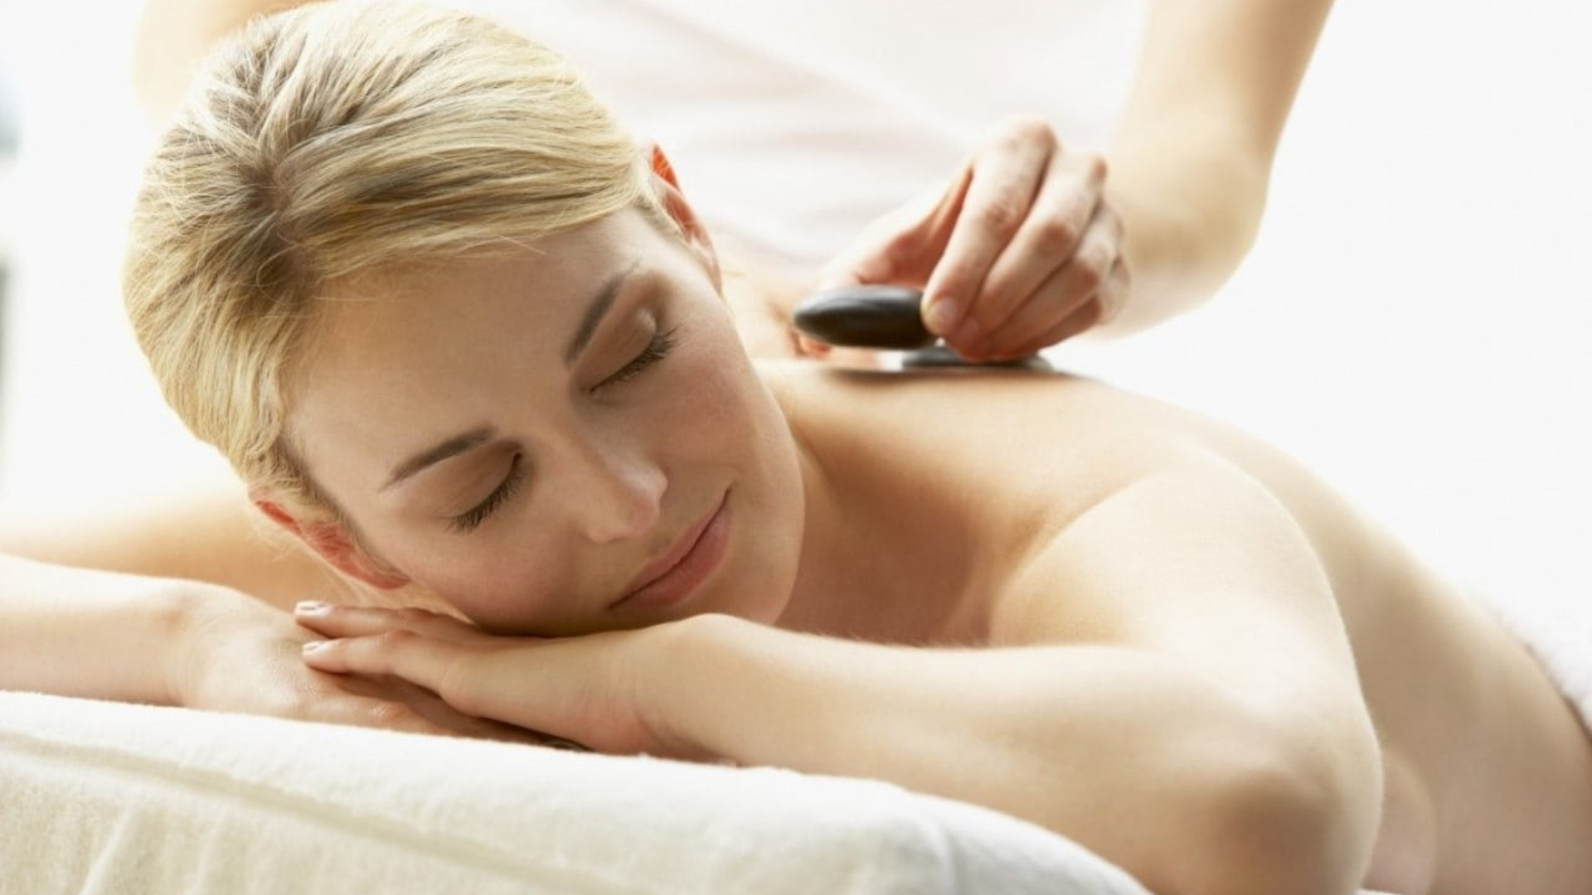
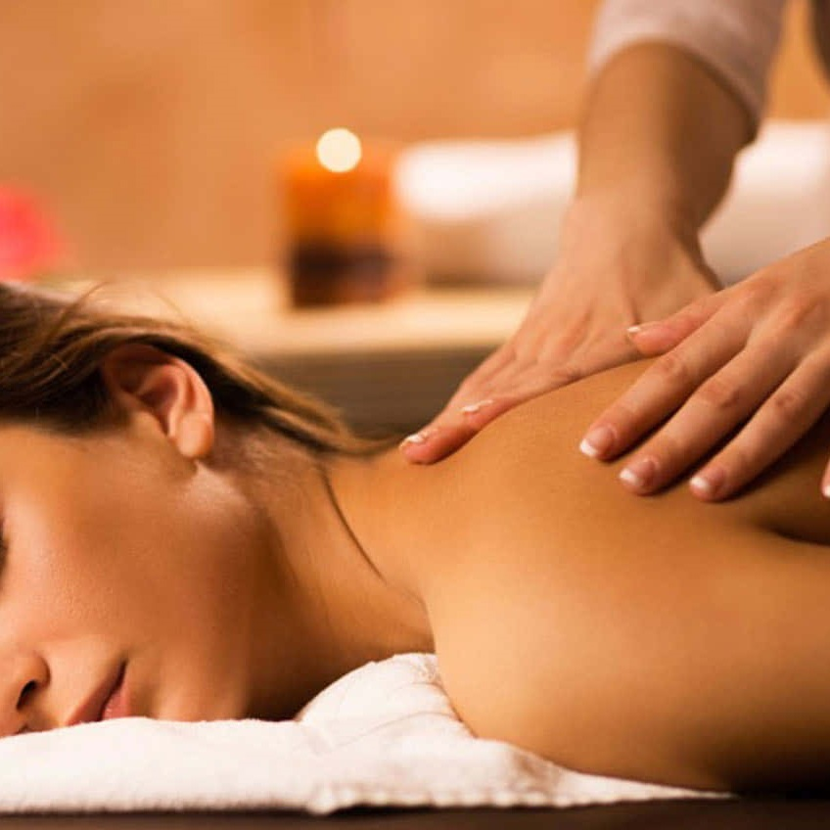
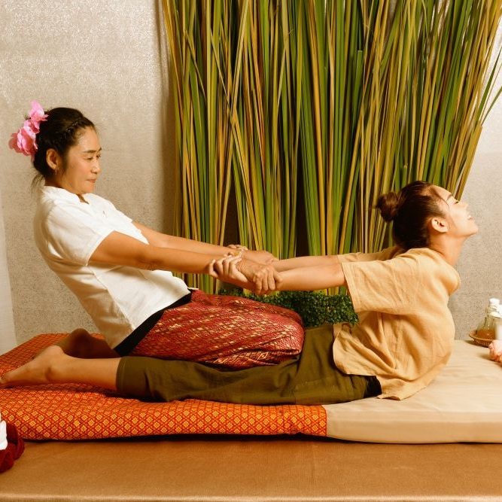
Home
Therapists
Book now
About us
Contacts
Profile
Sign out
Germany Mobile Spa
Roger Iskrenov
Verified practitioner pronouns: He/Him Field and specialty: Personal yoga trainer
Certifications & Training:
Licensed Massage Therapist (LMT)
Certified Yoga Instructor (RYT-500)
Specializations: Deep Tissue, Myofascial Release, Thai Yoga Massage
"Hi, I’m a certified massage therapist and personal yoga trainer with over 10 years of experience helping clients achieve balance, relaxation, and well-being. My holistic approach combines therapeutic massage techniques with personalized yoga sessions to bring harmony to body and mind."
Gallery
Services

Slide 63
Reaching ‘Therapist details’ from Booking template
Click to start presentation

Slide 64
Home
Therapists
Book now
About us
Contacts
Profile
Sign out
Germany Mobile Spa
Relax. Rejuvenate. Renew.
Discover the healing power of touch. Our expert massage therapies not only melt away stress but also improve circulation, relieve muscle tension, and promote overall well-being. Invest in your health —because you deserve it.
Find your closest therapist

Slide 65
Home
Therapists
Book now
About us
Contacts
Profile
Sign out
Germany Mobile Spa
Relax. Rejuvenate. Renew.
Discover the healing power of touch. Our expert massage therapies not only melt away stress but also improve circulation, relieve muscle tension, and promote overall well-being. Invest in your health —because you deserve it.
Find your closest therapist

Slide 66

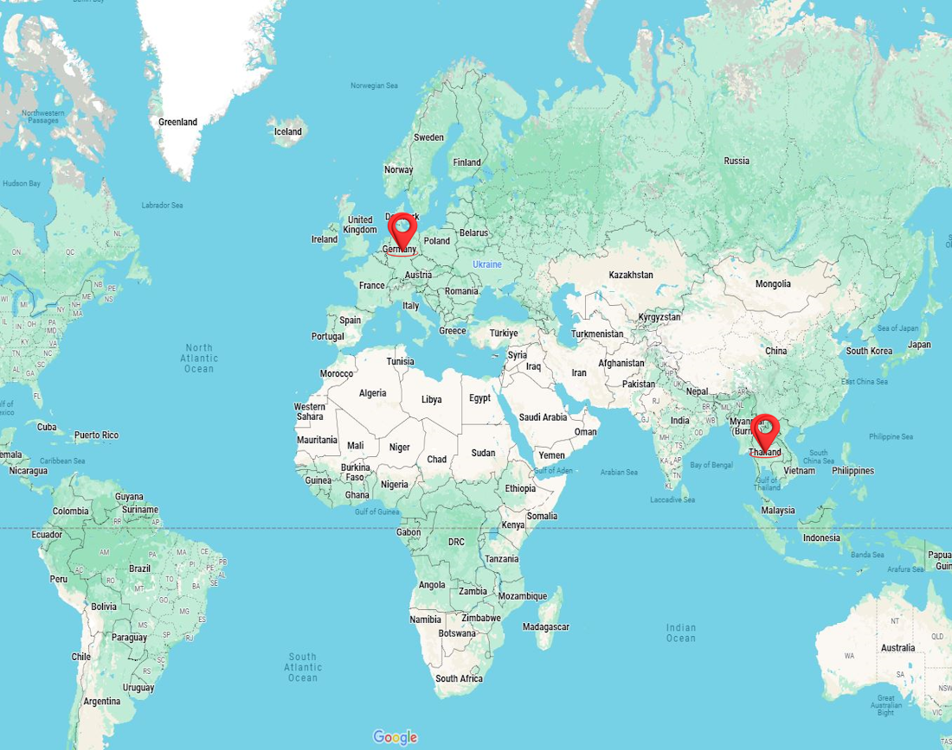
Home
Therapists
Book now
About us
Contacts
Profile
Sign out
Germany Mobile Spa
Relax. Rejuvenate. Renew.
Discover the healing power of touch. Our expert massage therapies not only melt away stress but also improve circulation, relieve muscle tension, and promote overall well-being. Invest in your health —because you deserve it.
Find your closest therapist
Enter your address
Choose a country
Choose a city
Services
Therapists
Continue

Slide 67
Relax. Rejuvenate. Renew.
Discover the healing power of touch. Our expert massage therapies not only melt away stress but also improve circulation, relieve muscle tension, and promote overall well-being. Invest in your health —because you deserve it.
Find your closest therapist
Home
Therapists
Book now
About us
Contacts
Profile
Sign out
Germany Mobile Spa
Enter your address
Choose a country
Choose a city
Services
Therapists
Continue

Slide 68
Home
Therapists
Book now
About us
Contacts
Profile
Sign out
Germany Mobile Spa
Enter your address
Choose a country
Choose a city
Services
Therapists
Continue

Slide 69


Home
Therapists
Book now
About us
Contacts
Profile
Sign out
Germany Mobile Spa
Enter your address
Choose a country
Germany
Choose a city
Thailand
Services
Therapists
Continue

Slide 70
Home
Therapists
Book now
About us
Contacts
Profile
Sign out
Germany Mobile Spa
Enter your address
Choose a country
Germany
Choose a city
Thailand
Services
Therapists
Continue

Slide 71
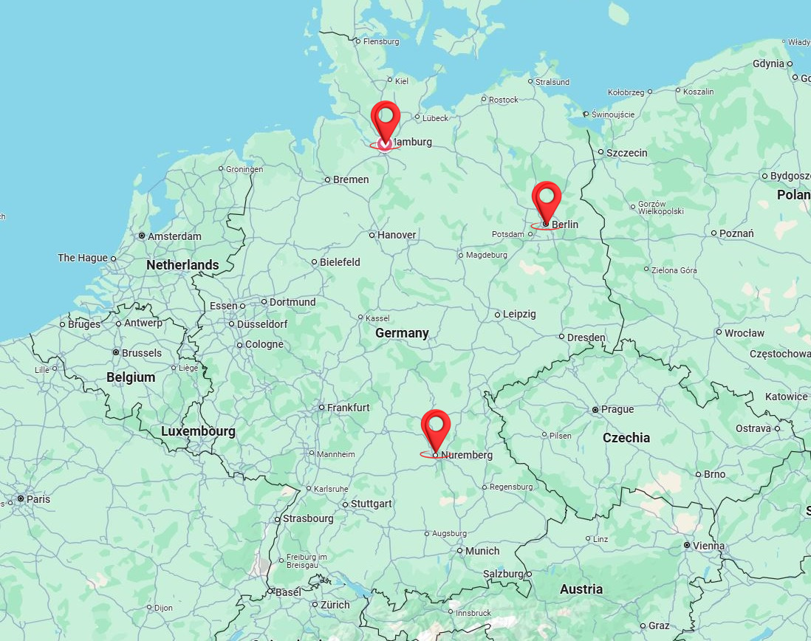
Home
Therapists
Book now
About us
Contacts
Profile
Sign out
Germany Mobile Spa
Enter your address
Germany
Choose a city
Services
Therapists
Continue

Slide 72
Home
Therapists
Book now
About us
Contacts
Profile
Sign out
Germany Mobile Spa
Enter your address
Germany
Choose a city
Services
Therapists
Continue

Slide 73
Home
Therapists
Book now
About us
Contacts
Profile
Sign out
Germany Mobile Spa
Enter your address
Germany
Choose a city
Berlin
Services
Hamburg
Stuttgard
Therapists
Continue

Slide 74
Home
Therapists
Book now
About us
Contacts
Profile
Sign out
Germany Mobile Spa
Enter your address
Germany
Choose a city
Berlin
Services
Hamburg
Stuttgard
Therapists
Continue

Slide 75
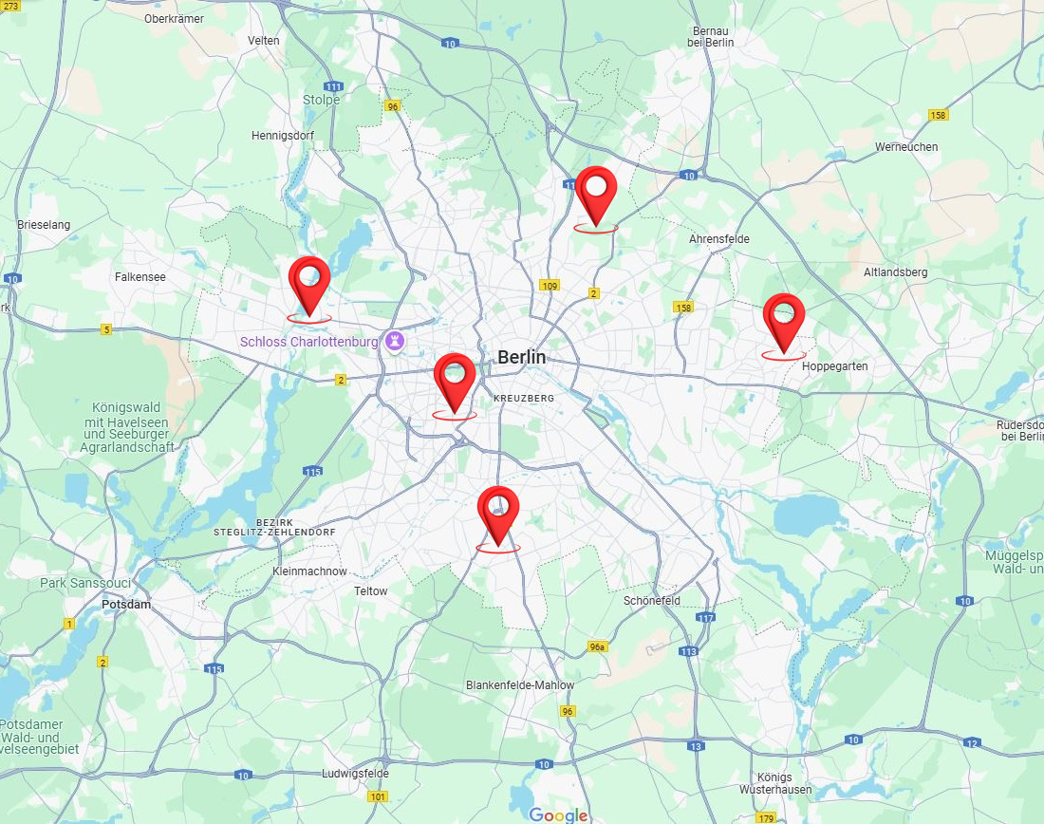
Home
Therapists
Book now
About us
Contacts
Profile
Sign out
Germany Mobile Spa
Enter your address
Germany
Berlin
Services
Therapists
Continue

Slide 76
Home
Therapists
Book now
About us
Contacts
Profile
Sign out
Germany Mobile Spa
Enter your address
Germany
Berlin
Services
Therapists
Continue

Slide 77
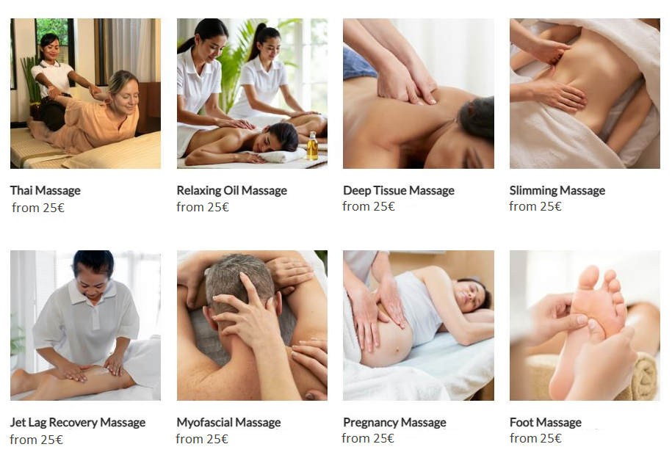
Home
Therapists
Book now
About us
Contacts
Profile
Sign out
Germany Mobile Spa
Enter your address
Germany
Berlin
Services
Therapists
Continue

Slide 78
Home
Therapists
Book now
About us
Contacts
Profile
Sign out
Germany Mobile Spa
Enter your address
Germany
Berlin
Services
Therapists
Continue

Slide 79
Home
Therapists
Book now
About us
Contacts
Profile
Sign out
Germany Mobile Spa
Enter your address
Germany
Berlin
Services
Therapists
Continue

Slide 80
Home
Therapists
Book now
About us
Contacts
Profile
Sign out
Germany Mobile Spa
Enter your address
Germany
Berlin
Thai Massage
Therapists
Continue

Slide 81
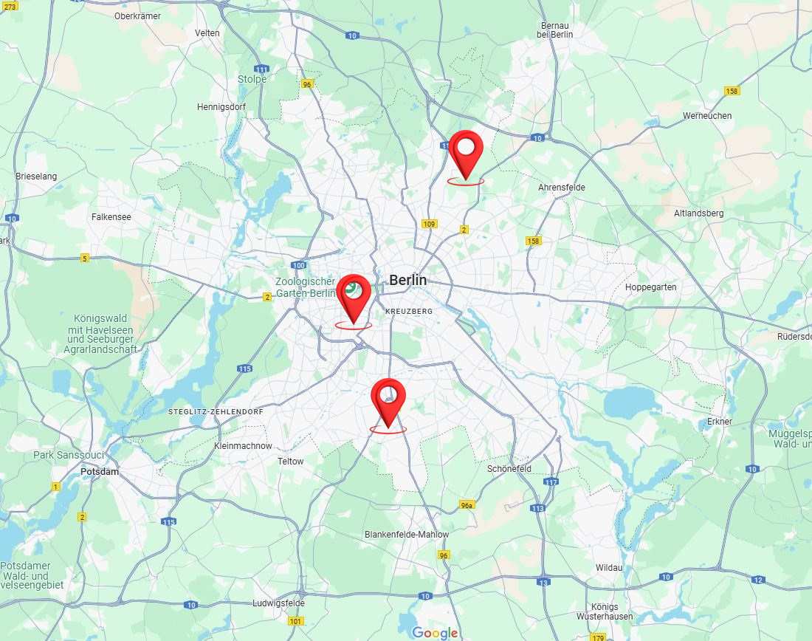
Home
Therapists
Book now
About us
Contacts
Profile
Sign out
Germany Mobile Spa
Enter your address
Germany
Berlin
Thai Massage
Therapists
Continue

Slide 82
Home
Therapists
Book now
About us
Contacts
Profile
Sign out
Germany Mobile Spa
Enter your address
Germany
Berlin
Thai Massage
Therapists
Continue

Slide 83
Home
Therapists
Book now
About us
Contacts
Profile
Sign out
Germany Mobile Spa
Enter your address
Germany
Berlin
Thai Massage
Therapists
Continue

Slide 84
Home
Therapists
Book now
About us
Contacts
Profile
Sign out
Germany Mobile Spa
Enter your address
Germany
Berlin
Thai Massage
Therapists
Continue

Slide 85
Home
Therapists
Book now
About us
Contacts
Profile
Sign out
Germany Mobile Spa
Enter your address
Germany
Berlin
Thai Massage
Therapists
Roger Iskrenov, Personal Yoga Instructor
Salma Buena, Body Toucher
Antonio Pereira, Foot Licker, 5.4 km away
Continue

Slide 86
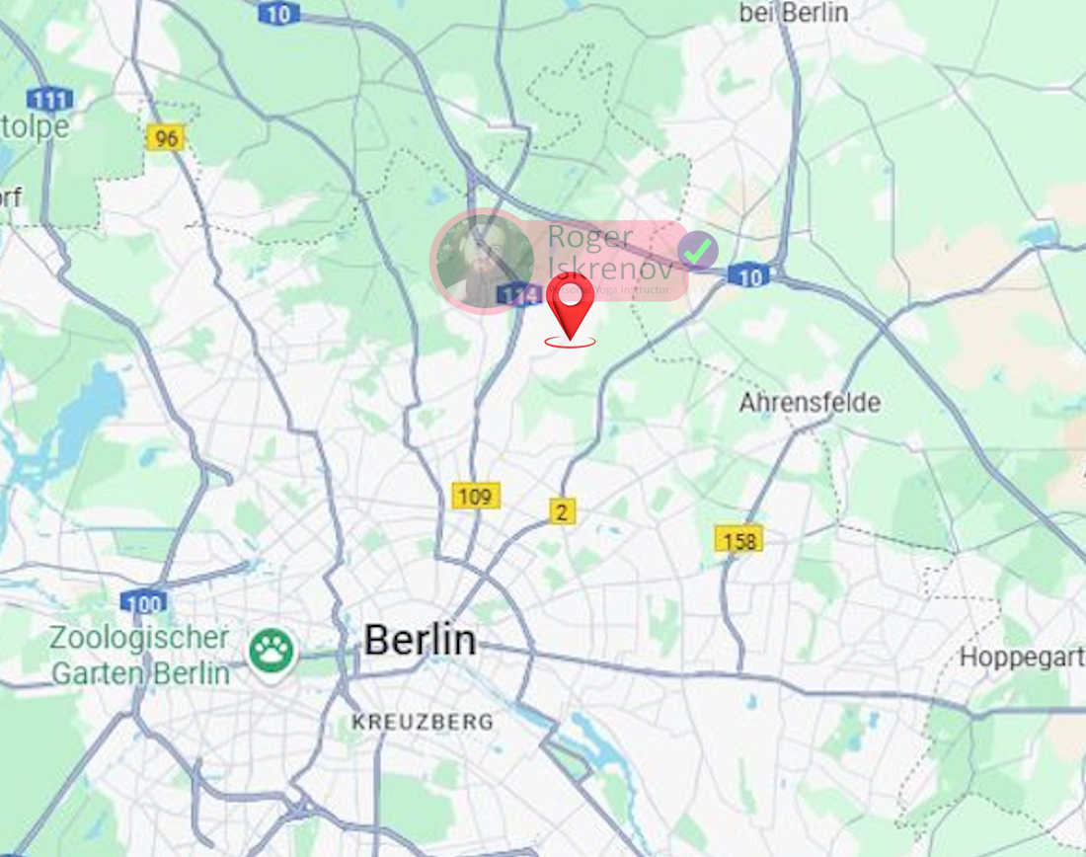
Home
Therapists
Book now
About us
Contacts
Profile
Sign out
Germany Mobile Spa
Enter your address
Germany
Berlin
Thai Massage
Roger Iskrenov
Continue

Slide 87
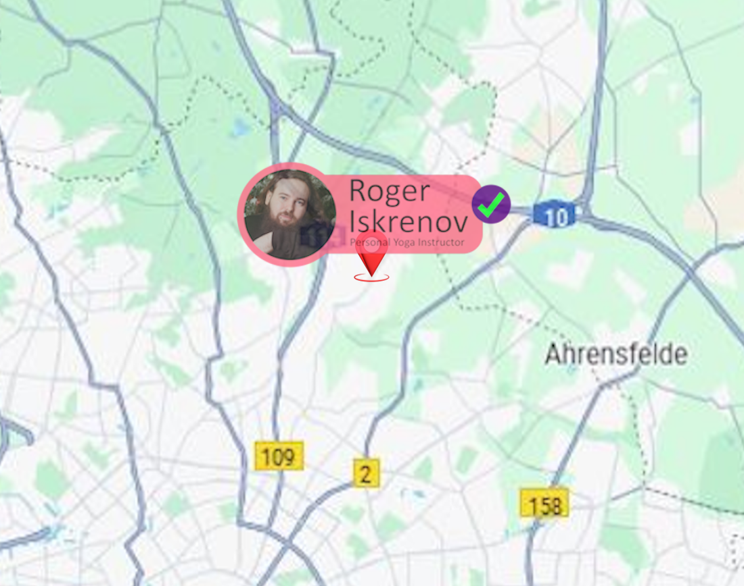
Home
Therapists
Book now
About us
Contacts
Profile
Sign out
Germany Mobile Spa
Enter your address
Germany
Berlin
Thai Massage
Roger Iskrenov
Continue

Slide 88
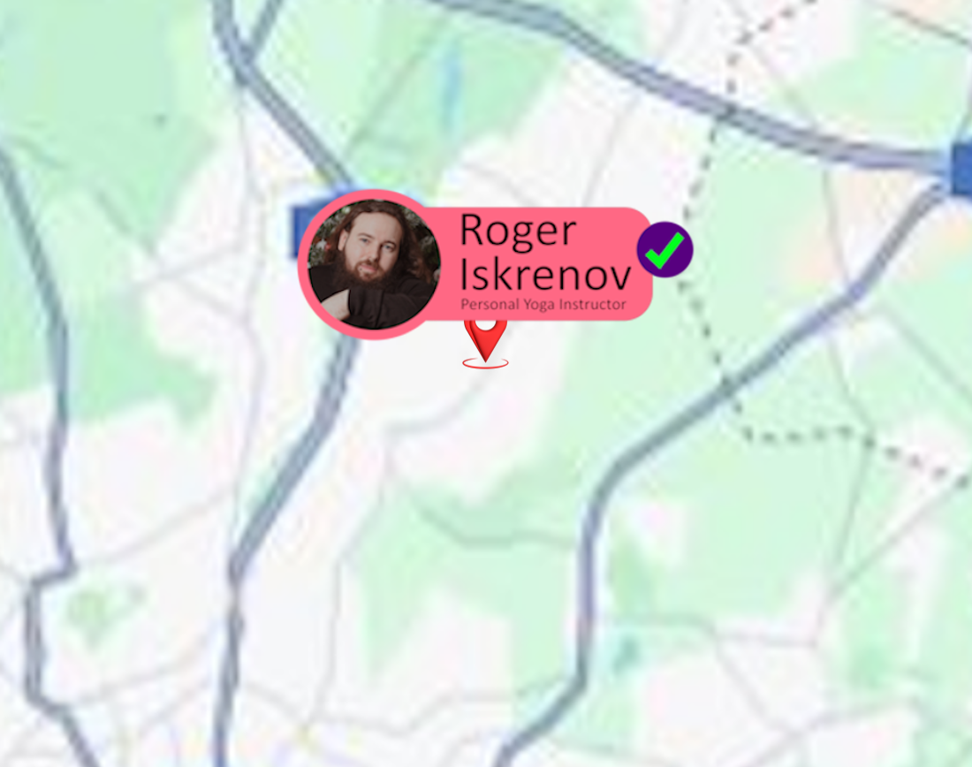
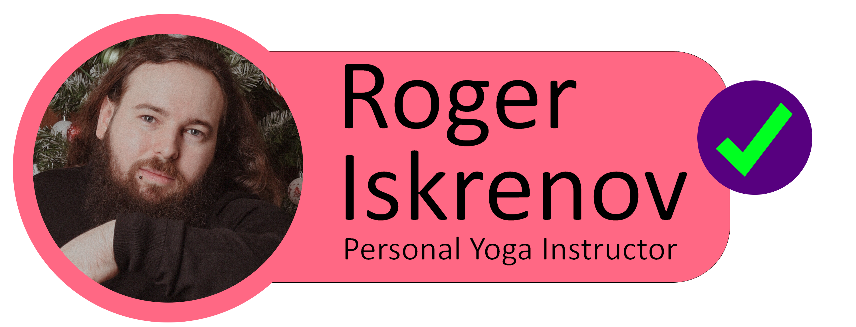
Home
Therapists
Book now
About us
Contacts
Profile
Sign out
Germany Mobile Spa
Enter your address
Germany
Berlin
Thai Massage
Roger Iskrenov
Continue

Slide 89
Home
Therapists
Book now
About us
Contacts
Profile
Sign out
Germany Mobile Spa
Enter your address
Germany
Berlin
Thai Massage
Roger Iskrenov
Continue

Slide 90
Home
Therapists
Book now
About us
Contacts
Profile
Sign out
Germany Mobile Spa
Enter your address
Germany
Berlin
Thai Massage
Roger Iskrenov
Continue

Slide 91
Home
Therapists
Book now
About us
Contacts
Profile
Sign out
Germany Mobile Spa

Slide 92
Home
Therapists
Book now
About us
Contacts
Profile
Sign out
Germany Mobile Spa
Roger Iskrenov
Verified practitioner pronouns: He/Him Field and specialty: Personal yoga trainer
Certifications & Training:
Licensed Massage Therapist (LMT)
Certified Yoga Instructor (RYT-500)
Specializations: Deep Tissue, Myofascial Release, Thai Yoga Massage
"Hi, I’m a certified massage therapist and personal yoga trainer with over 10 years of experience helping clients achieve balance, relaxation, and well-being. My holistic approach combines therapeutic massage techniques with personalized yoga sessions to bring harmony to body and mind."
Gallery
Services

Slide 93
Home
Therapists
Book now
About us
Contacts
Profile
Sign out
Germany Mobile Spa
Roger Iskrenov
Verified practitioner pronouns: He/Him Field and specialty: Personal yoga trainer
Certifications & Training:
Licensed Massage Therapist (LMT)
Certified Yoga Instructor (RYT-500)
Specializations: Deep Tissue, Myofascial Release, Thai Yoga Massage
"Hi, I’m a certified massage therapist and personal yoga trainer with over 10 years of experience helping clients achieve balance, relaxation, and well-being. My holistic approach combines therapeutic massage techniques with personalized yoga sessions to bring harmony to body and mind."
Gallery
Services

Slide 94
Home
Therapists
Book now
About us
Contacts
Profile
Sign out
Germany Mobile Spa
Roger Iskrenov
Verified practitioner pronouns: He/Him Field and specialty: Personal yoga trainer
Certifications & Training:
Licensed Massage Therapist (LMT)
Certified Yoga Instructor (RYT-500)
Specializations: Deep Tissue, Myofascial Release, Thai Yoga Massage
"Hi, I’m a certified massage therapist and personal yoga trainer with over 10 years of experience helping clients achieve balance, relaxation, and well-being. My holistic approach combines therapeutic massage techniques with personalized yoga sessions to bring harmony to body and mind."
Gallery
Services

Slide 95
Home
Therapists
Book now
About us
Contacts
Profile
Sign out
Germany Mobile Spa
Roger Iskrenov
Verified practitioner pronouns: He/Him Field and specialty: Personal yoga trainer
Certifications & Training:
Licensed Massage Therapist (LMT)
Certified Yoga Instructor (RYT-500)
Specializations: Deep Tissue, Myofascial Release, Thai Yoga Massage
"Hi, I’m a certified massage therapist and personal yoga trainer with over 10 years of experience helping clients achieve balance, relaxation, and well-being. My holistic approach combines therapeutic massage techniques with personalized yoga sessions to bring harmony to body and mind."
Gallery
Services

Slide 96
Home
Therapists
Book now
About us
Contacts
Profile
Sign out
Germany Mobile Spa
Roger Iskrenov
Verified practitioner pronouns: He/Him Field and specialty: Personal yoga trainer
Certifications & Training:
Licensed Massage Therapist (LMT)
Certified Yoga Instructor (RYT-500)
Specializations: Deep Tissue, Myofascial Release, Thai Yoga Massage
"Hi, I’m a certified massage therapist and personal yoga trainer with over 10 years of experience helping clients achieve balance, relaxation, and well-being. My holistic approach combines therapeutic massage techniques with personalized yoga sessions to bring harmony to body and mind."
Gallery
Services

Slide 97
Home
Therapists
Book now
About us
Contacts
Profile
Sign out
Germany Mobile Spa
Roger Iskrenov
Verified practitioner pronouns: He/Him Field and specialty: Personal yoga trainer
Certifications & Training:
Licensed Massage Therapist (LMT)
Certified Yoga Instructor (RYT-500)
Specializations: Deep Tissue, Myofascial Release, Thai Yoga Massage
"Hi, I’m a certified massage therapist and personal yoga trainer with over 10 years of experience helping clients achieve balance, relaxation, and well-being. My holistic approach combines therapeutic massage techniques with personalized yoga sessions to bring harmony to body and mind."
Gallery
Services
Services
Our practitioners are available daily from 8.00am until 7.00pm. If requiring services after 7.00pm additional 200 Baht/hour will be added to each service.
Thai Massage
Experience the ancient art of Thai massage. A therapeutic practice that combines gentle stretching, acupressure, and rhythmic movements. This full-body treatment promotes flexibility, relieves tension, and restores balance, leaving you refreshed and rejuvenated.
60 minutes: 25.00 € 90 minutes: 35.00 € 120 minutes: 45.00 €
Relaxing Oil Massage
Deep Tissue Massage
Slimming Massage
Jet Lag Massage
Myofascial Massage
Pregnancy Massage
Foot Massage
Foot Scrub
Body Scrub
Facial Treatment
Yoga Personal Trainer
Book
Manicure
Book
Pedicure
Book

Slide 98
Roger Iskrenov
Verified practitioner pronouns: He/Him Field and specialty: Personal yoga trainer
Certifications & Training:
Licensed Massage Therapist (LMT)
Certified Yoga Instructor (RYT-500)
Specializations: Deep Tissue, Myofascial Release, Thai Yoga Massage
"Hi, I’m a certified massage therapist and personal yoga trainer with over 10 years of experience helping clients achieve balance, relaxation, and well-being. My holistic approach combines therapeutic massage techniques with personalized yoga sessions to bring harmony to body and mind."
Gallery
Services
Home
Therapists
Book now
About us
Contacts
Profile
Sign out
Germany Mobile Spa
Services
Our practitioners are available daily from 8.00am until 7.00pm. If requiring services after 7.00pm additional 200 Baht/hour will be added to each service.
Thai Massage
Experience the ancient art of Thai massage. A therapeutic practice that combines gentle stretching, acupressure, and rhythmic movements. This full-body treatment promotes flexibility, relieves tension, and restores balance, leaving you refreshed and rejuvenated.
60 minutes: 25.00 € 90 minutes: 35.00 € 120 minutes: 45.00 €
Relaxing Oil Massage
Deep Tissue Massage
Slimming Massage
Jet Lag Massage
Myofascial Massage
Pregnancy Massage
Foot Massage
Foot Scrub
Body Scrub
Facial Treatment
Yoga Personal Trainer
Book
Manicure
Pedicure

Slide 99
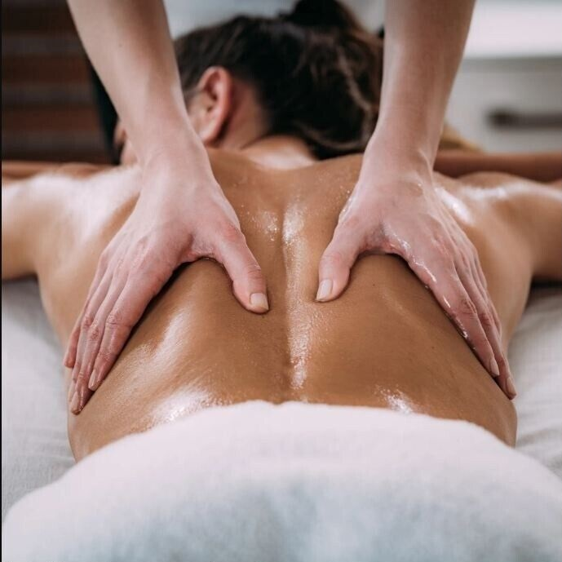
Home
Therapists
Book now
About us
Contacts
Profile
Sign out
Germany Mobile Spa
Services
Our practitioners are available daily from 8.00am until 7.00pm. If requiring services after 7.00pm additional 200 Baht/hour will be added to each service.
Thai Massage
Indulge in a Relaxing Oil Massage, designed to melt away stress and soothe your senses. Smooth, flowing strokes with aromatic oils ease muscle tension, enhance circulation, and promote deep relaxation, leaving you feeling calm, refreshed, and rejuvenated.
60 minutes: 25.00 € 90 minutes: 35.00 € 120 minutes: 45.00 €
Relaxing Oil Massage
Deep Tissue Massage
Slimming Massage
Jet Lag Massage
Myofascial Massage
Pregnancy Massage
Foot Massage
Foot Scrub
Body Scrub
Facial Treatment
Yoga Personal Trainer
Book
Manicure
Pedicure

Slide 100
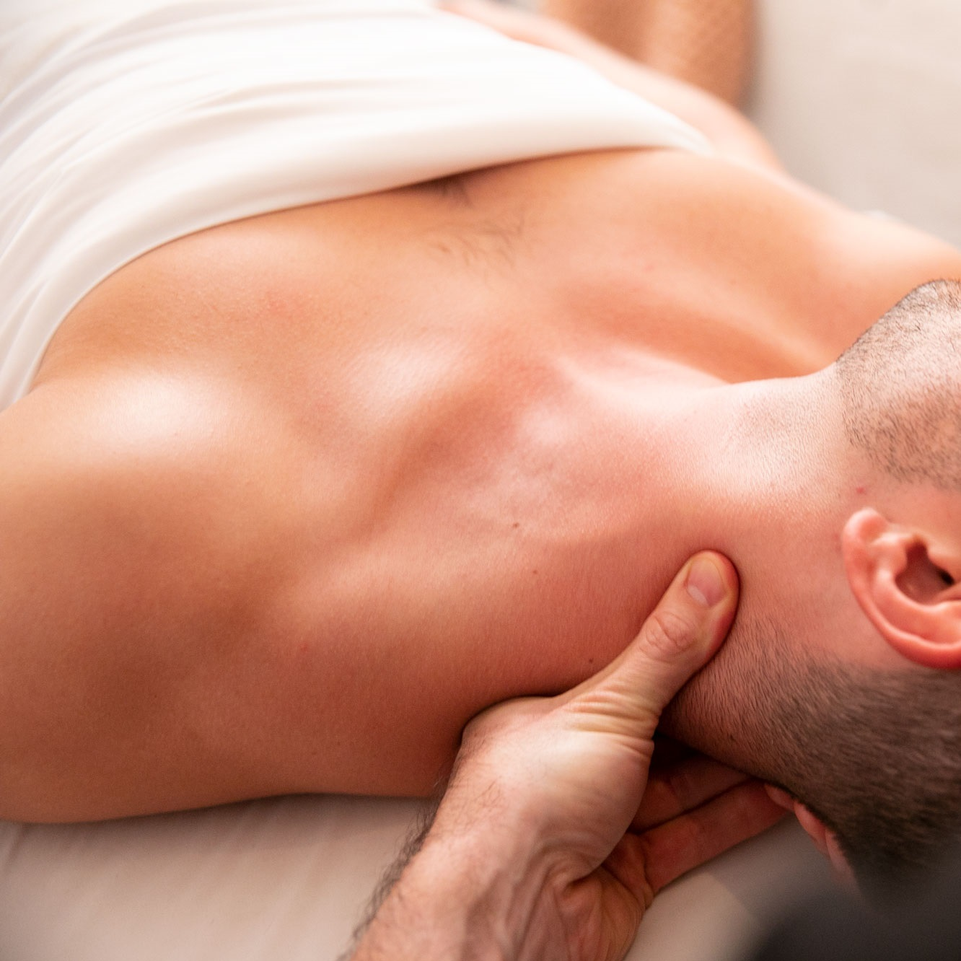
Home
Therapists
Book now
About us
Contacts
Profile
Sign out
Germany Mobile Spa
Services
Our practitioners are available daily from 8.00am until 7.00pm. If requiring services after 7.00pm additional 200 Baht/hour will be added to each service.
Thai Massage
The rejuvenating power of a Deep Tissue Massage, targeting deeper layers of muscle and connective tissue. With firm pressure and focused techniques, this treatment relieves chronic tension, eases tightness, and promotes recovery, leaving you feeling restored and revitalized.
60 minutes: 35.00 € 90 minutes: 50.00 € 120 minutes: 65.00 €
Relaxing Oil Massage
Deep Tissue Massage
Slimming Massage
Jet Lag Massage
Myofascial Massage
Pregnancy Massage
Foot Massage
Foot Scrub
Body Scrub
Facial Treatment
Yoga Personal Trainer
Book
Manicure
Pedicure
Discover the Benefits of Massage Therapy:
Relieves stress and anxiety
Eases muscle tension and pain
Improves circulation and flexibility
Boosts immune function and mental clarity
Why Choose Us? At [Your Business Name], we combine skill, care, and a serene environment to provide you with the ultimate relaxation experience. Our certified therapists customize each session to your needs, helping you unwind, rejuvenate, and restore balance.
Rechtliches
Impressum Datenschutzerklärung Einwilligungen widerrufen Historie der Privatsphäre-Einstellungen Privatsphäre-Einstellungen ändern
float HafenCity
Am Kaiserkai 42 20457 Hamburg Tel: 040 / 70 38 37 30 hafencity@float-hamburg.com
tägl. 10:00 – 22:00 Uhr
float Neustadt
Alter Steinweg 1 20459 Hamburg Tel: 040 / 36 93 54 64 neustadt@float-hamburg.com
tägl. 10:00 – 22:00 Uhr
float Rotherbaum
Mittelweg 160 20148 Hamburg Tel: 040 / 21 00 69 89 rotherbaum@float-hamburg.com
tägl. 10:00 – 22:00 Uhr
© 2024 [Your Business Name]. All rights reserved.
Follow us: [Social Media Icons]

Slide 101
Services
Our practitioners are available daily from 8.00am until 7.00pm. If requiring services after 7.00pm additional 200 Baht/hour will be added to each service.
Thai Massage
The rejuvenating power of a Deep Tissue Massage, targeting deeper layers of muscle and connective tissue. With firm pressure and focused techniques, this treatment relieves chronic tension, eases tightness, and promotes recovery, leaving you feeling restored and revitalized.
60 minutes: 35.00 € 90 minutes: 50.00 € 120 minutes: 65.00 €
Relaxing Oil Massage
Deep Tissue Massage
Slimming Massage
Jet Lag Massage
Myofascial Massage
Pregnancy Massage
Foot Massage
Foot Scrub
Body Scrub
Facial Treatment
Yoga Personal Trainer
Book
Manicure
Pedicure
Home
Therapists
Book now
About us
Contacts
Profile
Sign out
Germany Mobile Spa
Discover the Benefits of Massage Therapy:
Relieves stress and anxiety
Eases muscle tension and pain
Improves circulation and flexibility
Boosts immune function and mental clarity
Why Choose Us? At [Your Business Name], we combine skill, care, and a serene environment to provide you with the ultimate relaxation experience. Our certified therapists customize each session to your needs, helping you unwind, rejuvenate, and restore balance.
Rechtliches
Impressum Datenschutzerklärung Einwilligungen widerrufen Historie der Privatsphäre-Einstellungen Privatsphäre-Einstellungen ändern
float HafenCity
Am Kaiserkai 42 20457 Hamburg Tel: 040 / 70 38 37 30 hafencity@float-hamburg.com
tägl. 10:00 – 22:00 Uhr
float Neustadt
Alter Steinweg 1 20459 Hamburg Tel: 040 / 36 93 54 64 neustadt@float-hamburg.com
tägl. 10:00 – 22:00 Uhr
float Rotherbaum
Mittelweg 160 20148 Hamburg Tel: 040 / 21 00 69 89 rotherbaum@float-hamburg.com
tägl. 10:00 – 22:00 Uhr
© 2024 [Your Business Name]. All rights reserved.
Follow us: [Social Media Icons]

Slide 102
The end
Click to exit

